Slide 1
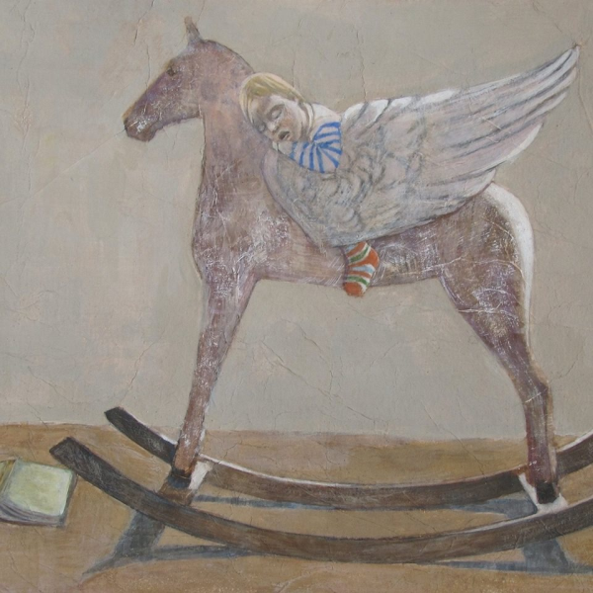
Curators. Panoply Vase Animation Project http://panoply.org.uk
This PowerPoint was developed to accompany
the lesson-plan chapters ‘Curation Challenge’ by Jennie Thornber and
‘Displaying Animations’ by Louise Maguire, in
Teaching Ancient Greece. Lesson Plans, Vase Animations, and Resources, edited by Sonya Nevin.
Teaching Ancient Greece is an Open Access publication available for
free download from the University of Warsaw Press.
This PowerPoint can also be used independently of
Teaching Ancient Greece.

Slide 2
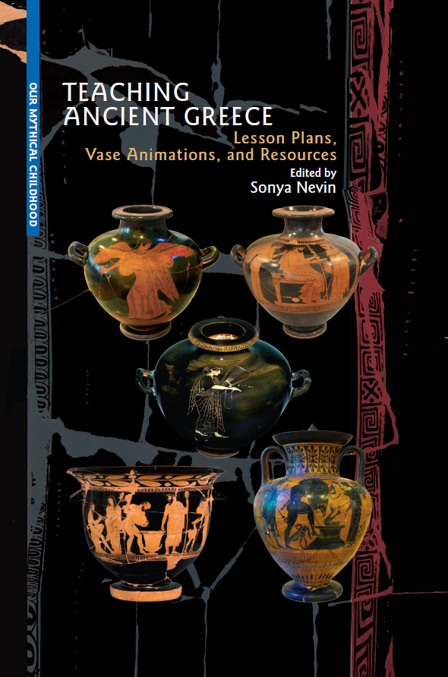
This PowerPoint was made by Dr Sonya Nevin of the Panoply Vase Animation Project, for the ERC-funded project
Our Mythical Childhood: http://www.omc.obta.al.uw.edu.pl/
Feel free to use this PowerPoint for educational purposes, including editing it.
Please do not post it online. If you would like to share it, please share its url.
The PowerPoint can be downloaded from:
https://panoply.org.uk/further-resources

Slide 3
What is a curator?
A curator is a person who oversees or manages a place that presents exhibits – things for people to see - often a museum, a gallery, or a country house.

Slide 4
In a small place, the curator might be responsible for the whole institution, working on their own or with a small team.
Someone might say, for example:
“She is the curator of the museum,” meaning that she runs the museum.
In a larger place, they may be responsible for a particular part of the collection as one of many curators.
Someone might say: “He is the curator of the pottery gallery in the museum,” meaning that he runs a particular part of a museum.

Slide 5
Where does the word ‘curator’ come from?
‘Curator’ comes from the Latin word cūrātor’ one who looks after, superintendent, guardian,’ from cūrāre’ to watch over, attend’.
You may know related words:
Cure – to heal by looking after.
Curate – as a noun (‘a curate’), a clergyman who looks after the members of a church. As a verb (‘to curate’), the work of looking after a collection.
Curious – wishing to know things; derived from a sense of being careful.
Curiosity – a feeling of being curious, or an object people might be curious about, that is wish to know more about.

Slide 6
Let’s see what some museums and galleries say about what curators do:

Slide 7
Tate Museum, London, UK.
“A curator is someone employed by a museum or gallery to manage a collection of artworks or artefacts.
Museums and galleries typically employ numbers of curators whose role it is to acquire, care for and develop a collection. They will also arrange displays of collection and loaned works and interpret the collection in order to inform, educate and inspire the public.”
https://www.tate.org.uk/art/art-terms/c/curator

Slide 8
Art Gallery of South Australia
“Curators, along with artists, are storytellers in their own right. Curators make decisions about which works of art should be displayed and how they should be seen. They also decide on the themes and ideas to be experienced by the audience.”
https://www.agsa.sa.gov.au/education/resources-educators/agsa-art-school-online/what-curator/

Slide 9
Sotheby’s Institute of Art, UK.
“An art curator’s job is multi-faceted — it involves research, planning, and excellent communication skills when working with artists, art experts, and the general public. Their primary responsibilities include:
Curating exhibitions
Acquiring artworks
Research and interpretation
Public engagement
Administrative Tasks.”
https://www.sothebysinstitute.com/how-to-series/art-curator

Slide 10
And from the UK National Careers Service:
“In your day-to-day duties you may:
select, buy or borrow items
research, identify and catalogue collections
make sure exhibits are safe, stored securely and in the right conditions
arrange conservation and restoration
help visitors to interpret and enjoy exhibits and collections
organise publicity and fundraising
give talks
train or supervise gallery or museum volunteers or paid staff
negotiate funding and the loan of exhibits.”
https://nationalcareers.service.gov.uk/job-profiles/museum-curator

Slide 11
Let’s hear from some curators:

Slide 12
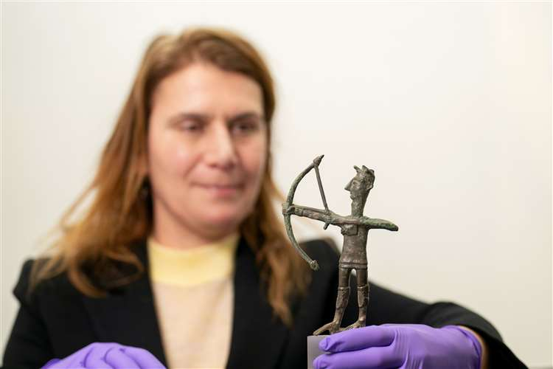
Dr Anastasia Christophilou.
“As Senior Curator of Mediterranean Antiquities the Fitzwilliam Museum, I am responsible for research and exhibition projects and permanent displays in the fields of Greek, Cypriot and Roman collections.”
“A week’s to-do list could include teaching undergraduate groups and supervision of doctoral students, researching the collections of Ancient Greece, Rome and Cyprus, working with our collections management and conservation teams on improving accessibility, storage and management of the collections, or presenting in research seminars… [and] public engagement.”
Read the full interview here on the Panoply Blog.

Slide 13
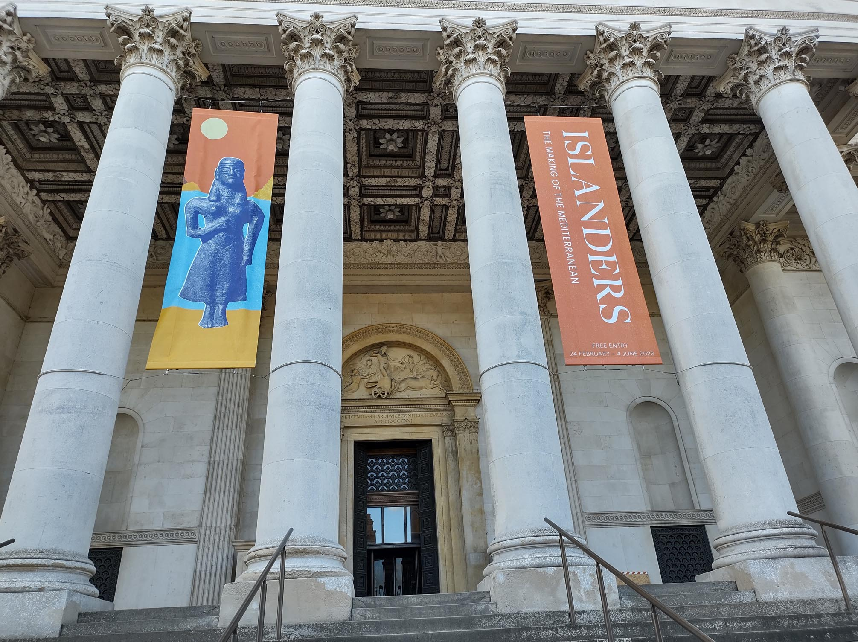
Anastasia was the curator of the blockbuster Islanders exhibition. It took a lot of organising to plan the exhibition and to bring artefacts from several museums into one:
“The exhibition brings together over 200 objects from the three Mediterranean islands, most never exhibited outside their museums in Crete, Cyprus and Sardinia, that tell exceptional stories of island identity, over a period of 5000 years.”

Slide 14
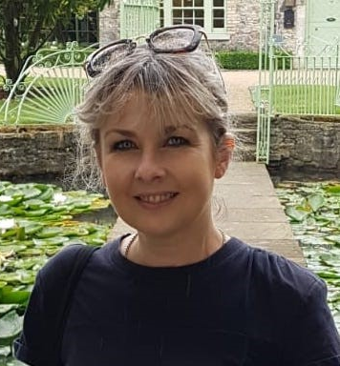
Sasha Smith, Assistant Curator of the University College Dublin Classical Museum.
“Every day starts with the same routine – check all the climate controls to ensure everything is as it should be for optimum care of the artefacts. Once that’s done, each day takes off at its own tangent as there is always something going on.”
“I am currently conducting a complete re-inventory of the collection. Once done, everything will go on our new collections management system (CMS) which will give the collection greater visibility online.”
“My desk is literally three feet from a 2nd century AD sarcophagus – no wonder I love coming into work!”
Read the full interview here on the Panoply Blog.

Slide 15
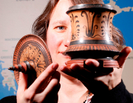
Prof Amy Smith, Curator of the Ure Museum of Greek Archaeology.
“The best thing about my job is that there’s no ‘typical week.’… The museum-specific work entails lots of paperwork and organisation too—applications for funding, arranging finances if someone’s kind enough to donate, purchasing equipment, organising events, etc.”
“From the birth of museums, their creators and curators have aimed to welcome people to them, to share knowledge of art, history, and the origins of civilisation, yet by the 20th century they had become misunderstood as bastions of privilege…. Technology has changed all that.”
Read the full interview here on the Panoply Blog.

Slide 16
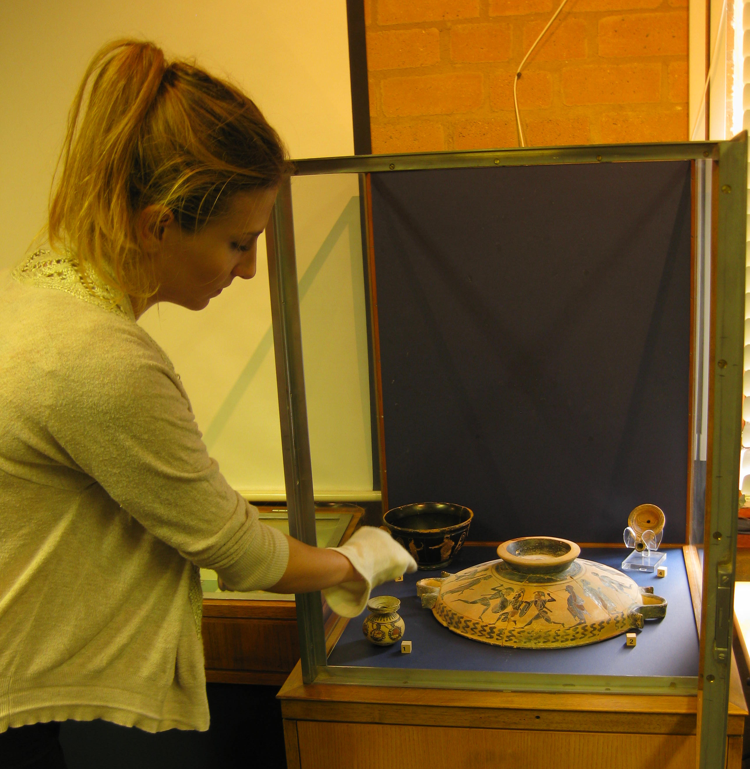
Gabrielle Turner carried out a museum internship - a temporary post designed to gain experience:
“During my internship at the Ure Museum I helped out with their database by logging-in artefacts, and helped with the temporary exhibition.”
For the exhibition she was working on, Gabrielle chose artefacts to put together, assembled them in a case, and wrote and printed text to display with them.
“I sent an email to the Ure Museum telling them about my interests and future career plans and asking if I could do an internship there. I got my lecturer to double-check my email. I attached my CV to the email.
The process was amazing, it felt great to have the responsibility that I was given. I enjoyed every moment of it and I would definitely recommend this experience to fellow students.”
Read the full interview
here on the Panoply Blog.

Slide 17
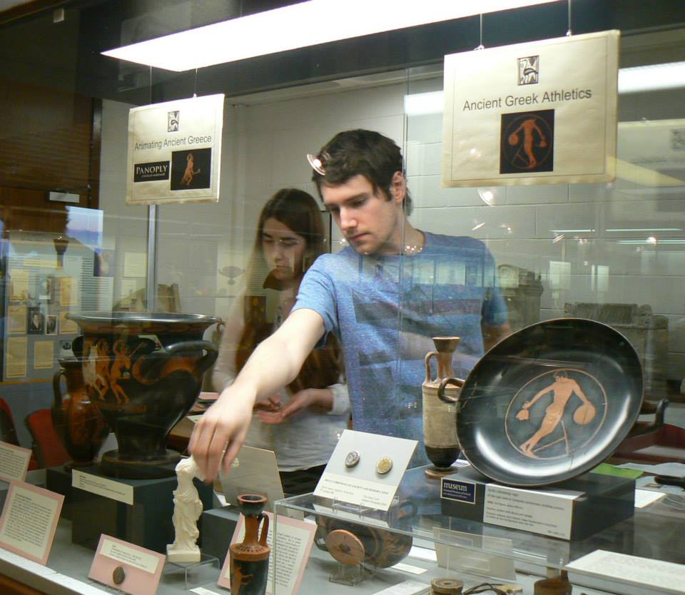
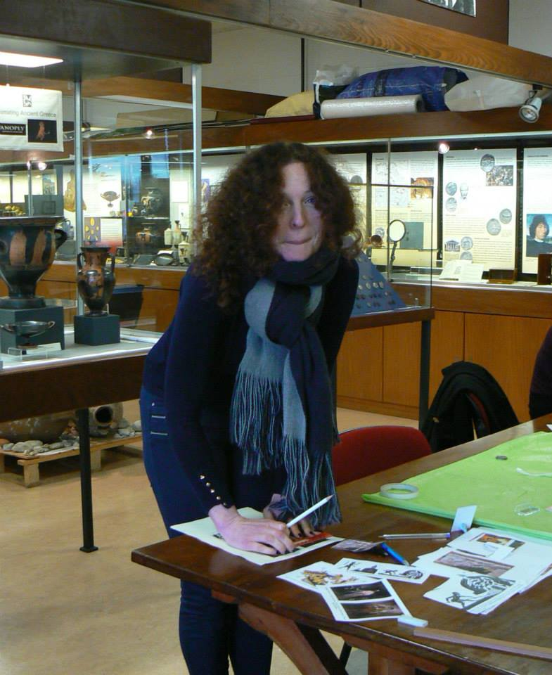
These students curated an exhibition
in the UCD Classical Museum. They had to:
Choose a theme (they chose the Goddess of Victory, Nike).
Decide which objects would express that theme.
Assemble the objects in a case.
Write and print text to accompany the objects.
They worked with Panoply to develop an animation based on one of the vases they had chosen. That became The Procession.

Slide 18
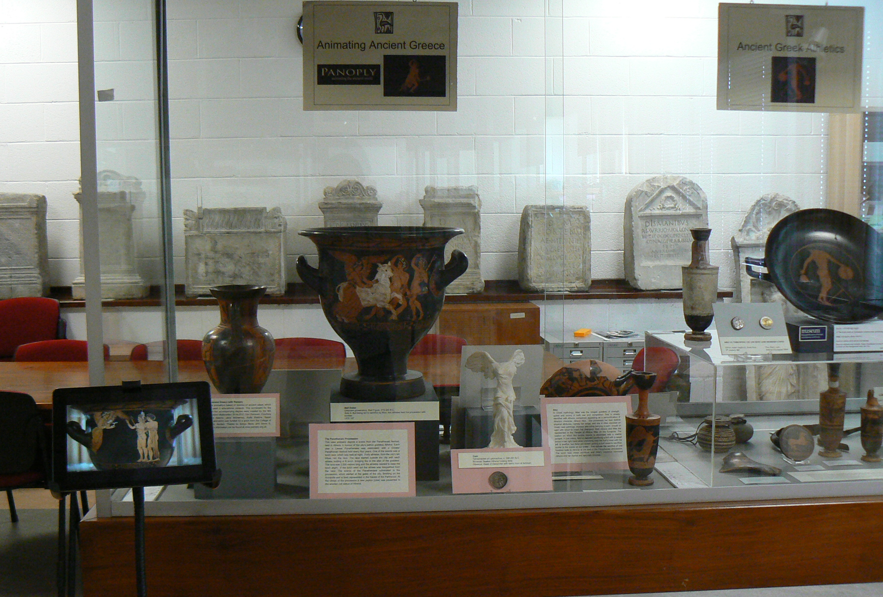
This was how the exhibition looked when they had completed it.
You can see more about it on the Panoply website: https://panoply.org.uk/nike
and on the Panoply Blog.

Slide 19
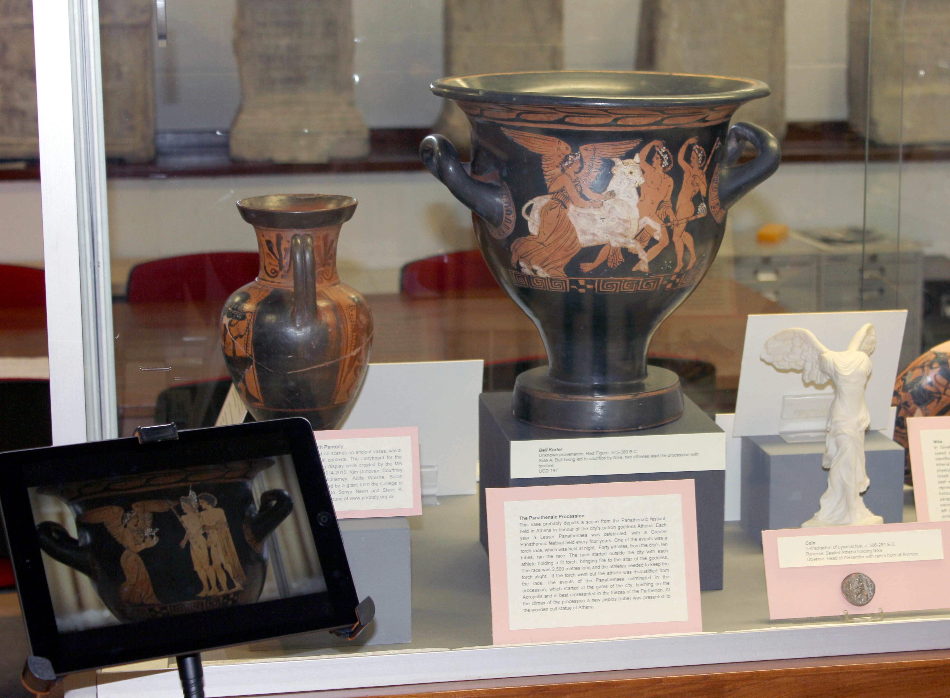
The vase animation and the vase it was made from were shown together so that museum visitors could see both at the same time.

Slide 20
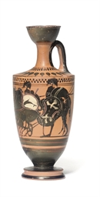
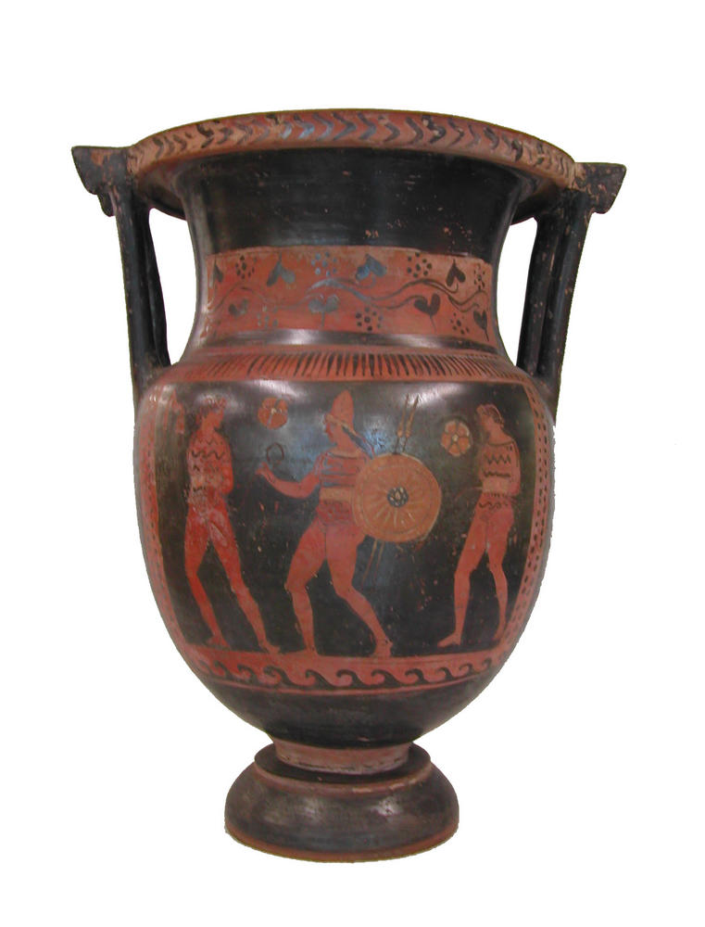
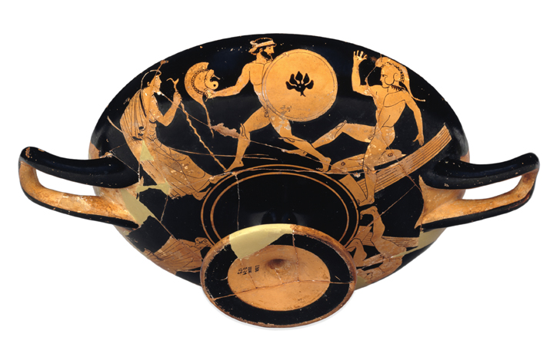
Let’s look at some of the decisions curators make when they are displaying objects.
We will focus particularly on ancient Greek collections.

Slide 21
What will you include in your object labels?
Objects displayed in museums and galleries are usually shown with an information label.
Common forms of information include:
What the object is.
What it is made of.
What it was used for.
Where it is from.
When it was made.

Slide 22
Other information could be added, such as:
Where the object was found, especially if that is different from where it was made.
Its museum or gallery inventory number.
Previous owners of the object, including who gave it to the museum or gallery.
Further information about, for example, symbolic meanings in images or shapes.
The same information in other languages.

Slide 23
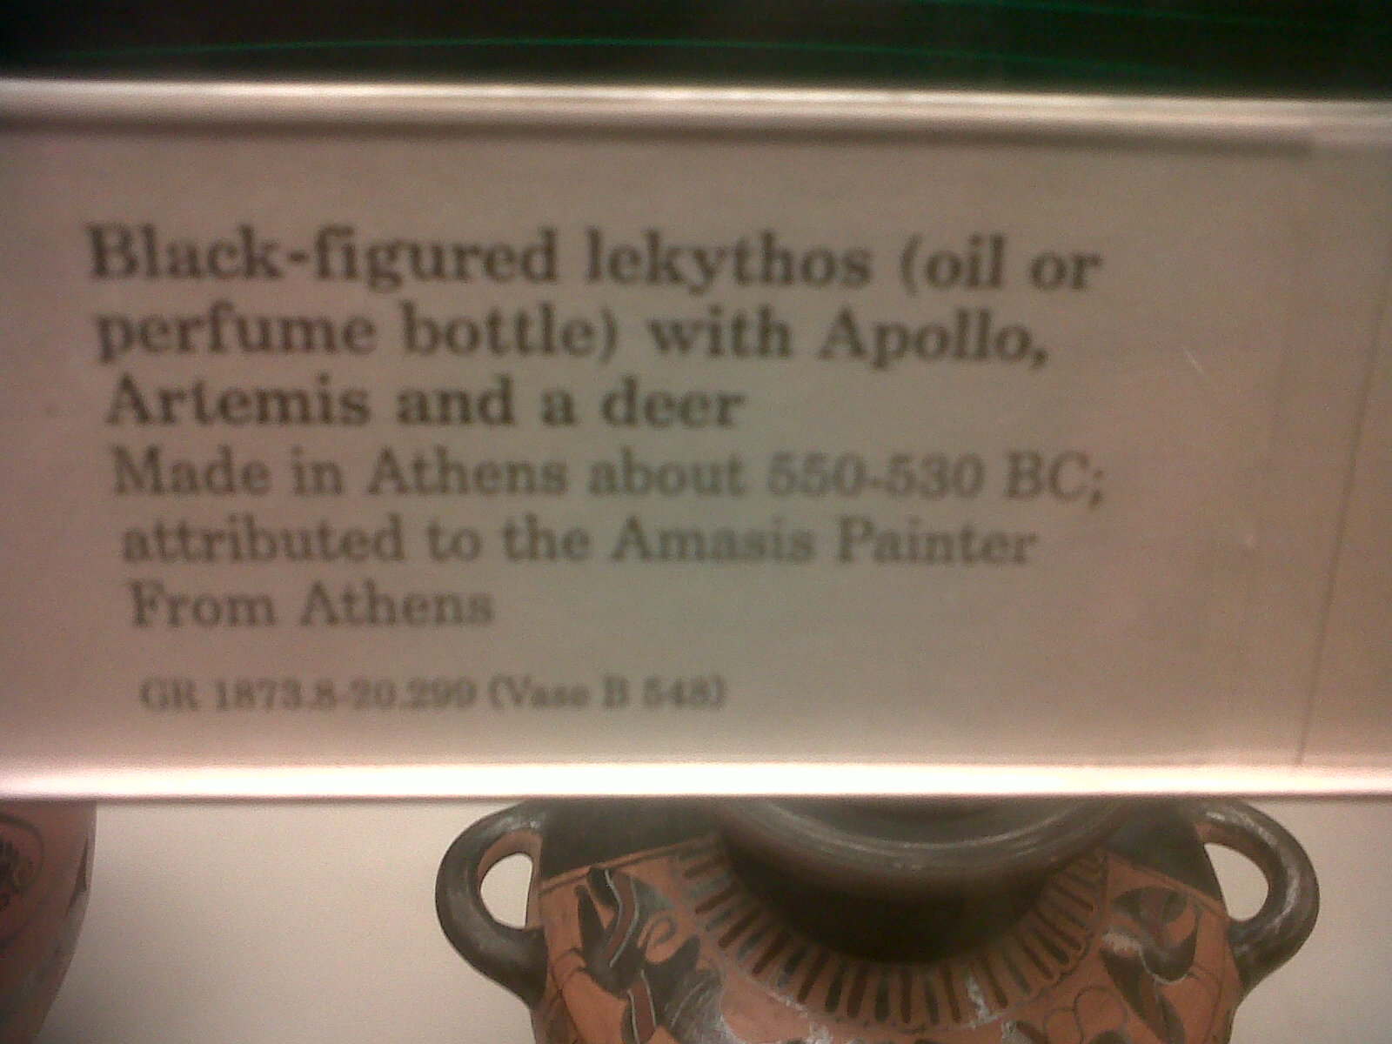
What information does this British Museum label contain?

Slide 24
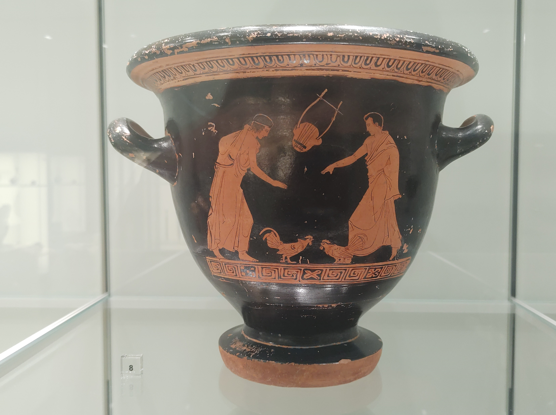
What has been included in this label from the National Museum in Warsaw, Poland? How do you know which label goes with which object?

Slide 25
How will you arrange the objects?
Some common approaches are:
Chronologically – in the order in which they were made. Think one case for very old objects, another for objects not quite so old, another for newer objects, and so on.
By type – placing similar objects together. Think all the vases together, all the statues together, all the metalwork together, and so on.
By theme – grouping objects to express a shared theme. Think a case for sport, one for music, one for cooking, one for myth, and so on.

Slide 26
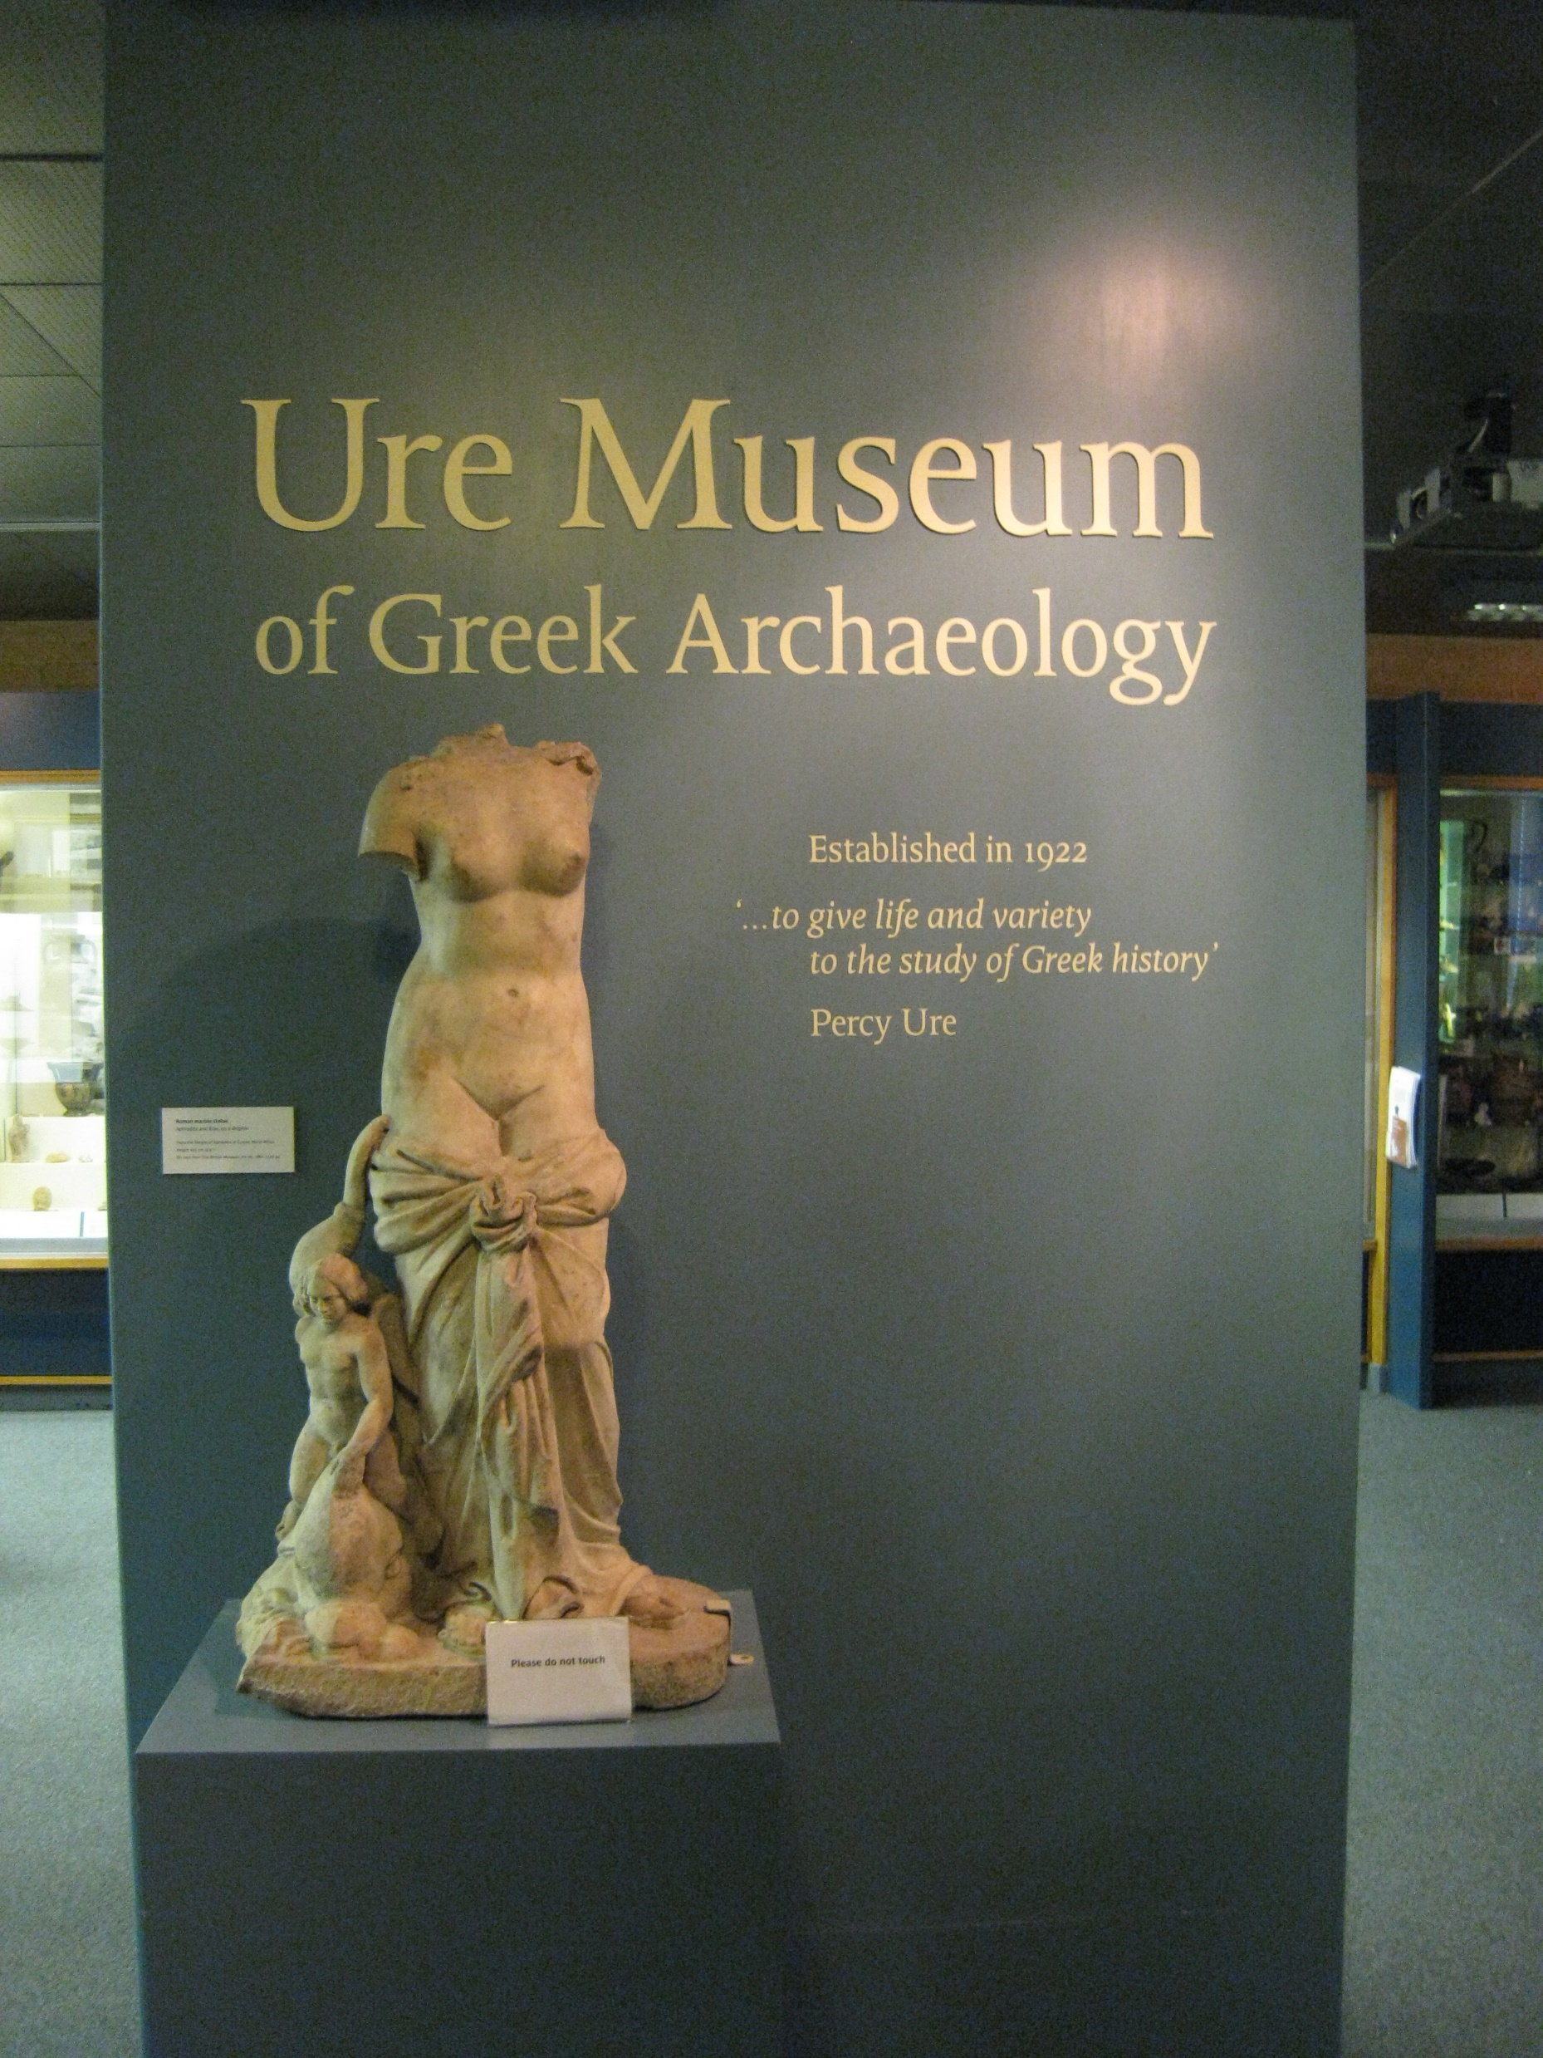
For many years, the Ure Museum of Greek Archaeology in the UK displayed their collection chronologically.
Curator, Amy Smith, reorganised it to display the objects by theme…

Slide 27
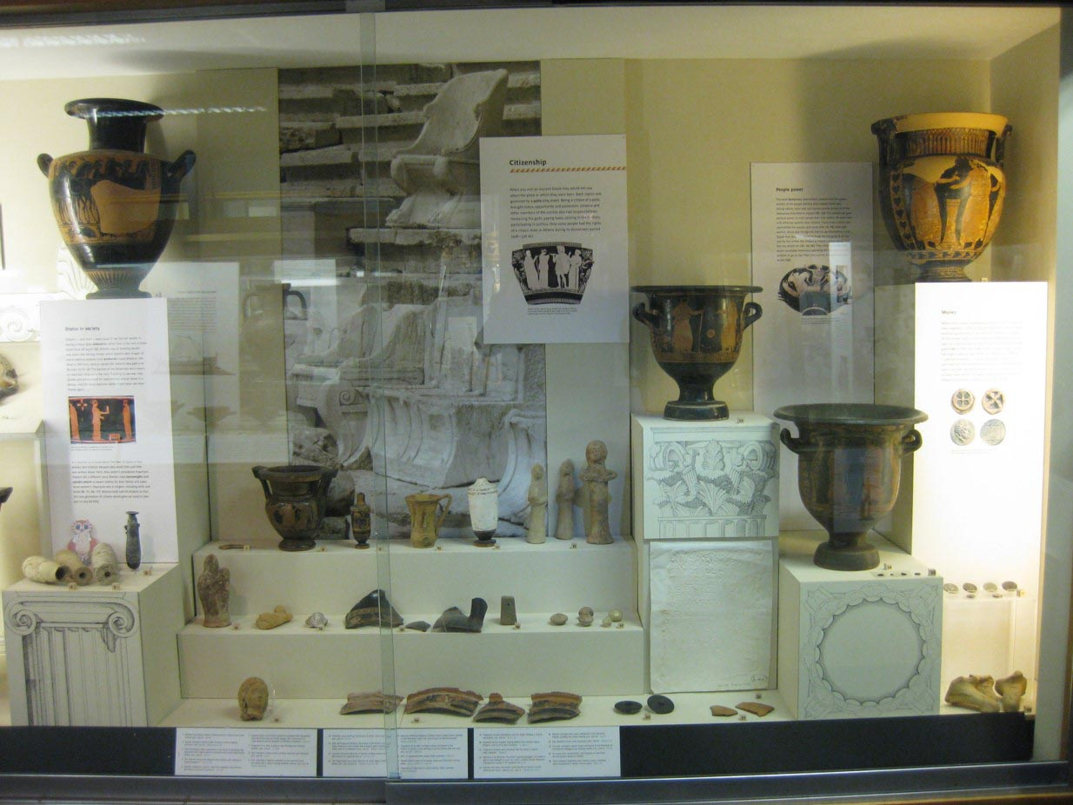
The theme of this case is Citizenship. There are different kinds of ancient Greek objects; together they show what was expected of an Athenian citizen.

Slide 28
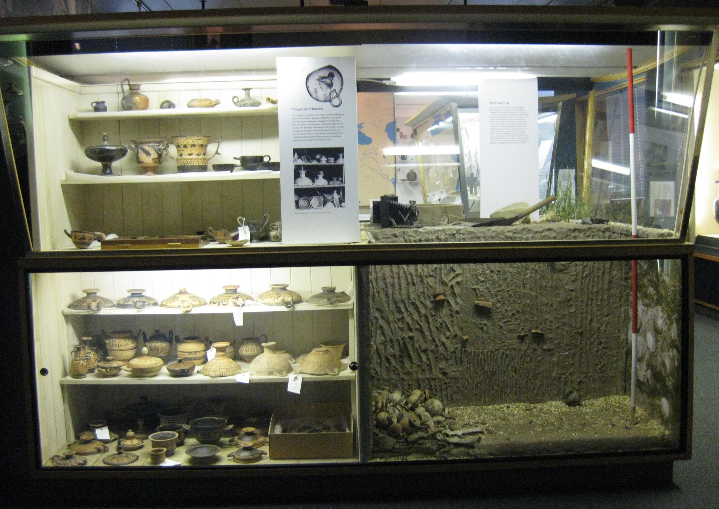
The theme of this case is Boeotia, a region of ancient Greece. The items are different but come from the same place. The right hand side shows you the environment in which some of the objects were found.

Slide 29
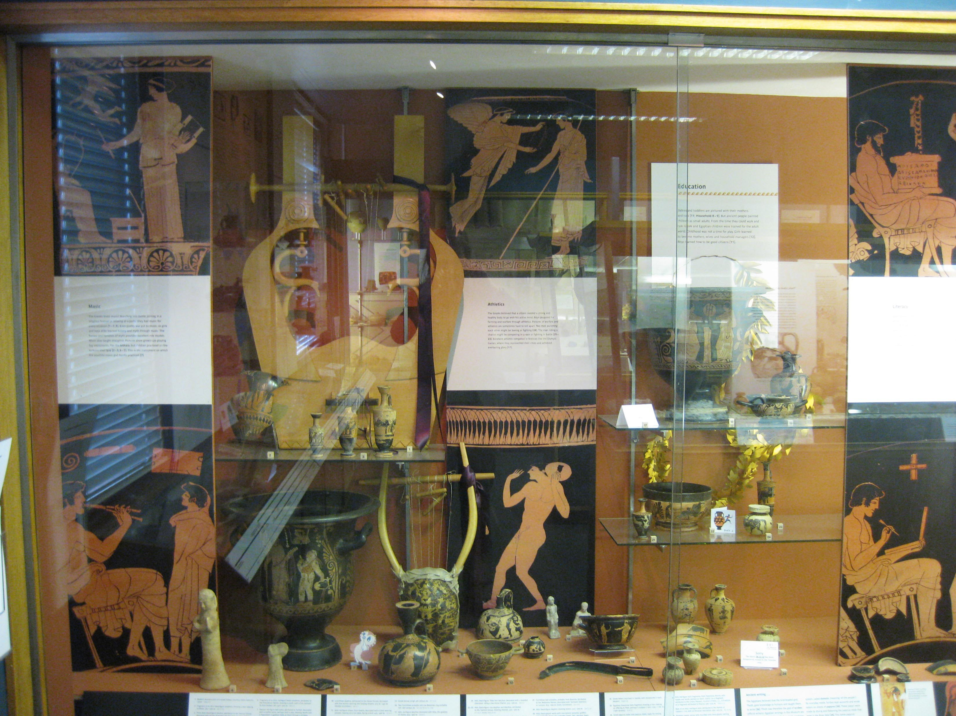
The theme here is Education. Different sections present different areas of ancient Greek education, including music, athletics, and reading and writing.

Slide 30
Notice how the curator has added enlarged images of objects to go with the artefacts. The music section includes a replica musical instrument as well as ancient objects connected to music and an enlarged image of a music lesson.

Slide 31
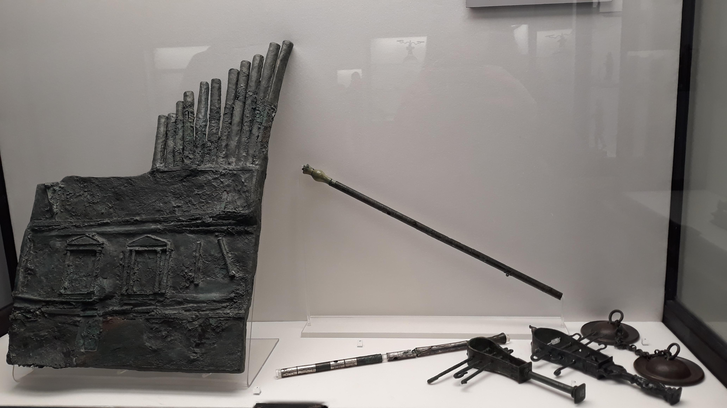
This is a themed case from the National Archaeological Museum in Naples, Italy. The theme is Music. This case has musical instruments and labels but no reproductions or enlarged images. There is no one way to present collections, but the curator’s choices affect the impression on the person looking at the objects.

Slide 32
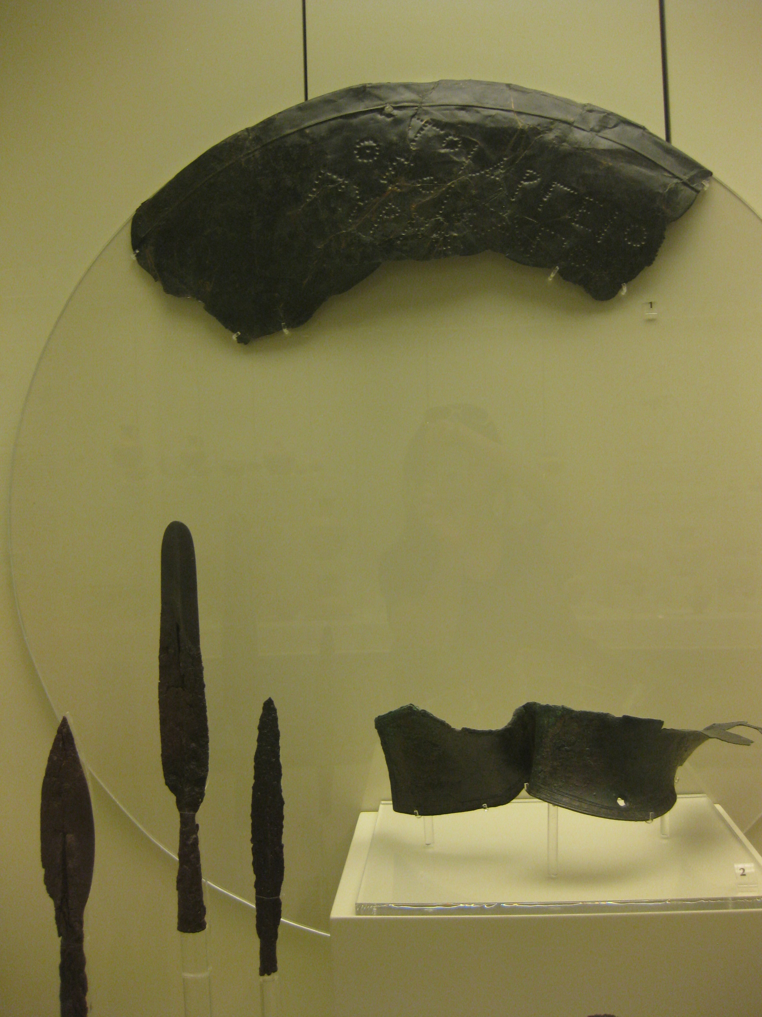
This case is from the Archaeological Museum of Mycenae, in Greece.
This is a themed case. The theme is Warfare, so spear-heads and a shield have been grouped together.
Only part of the shield has survived.
Notice how it has been positioned to help us imagine the rest of the shield.

Slide 33
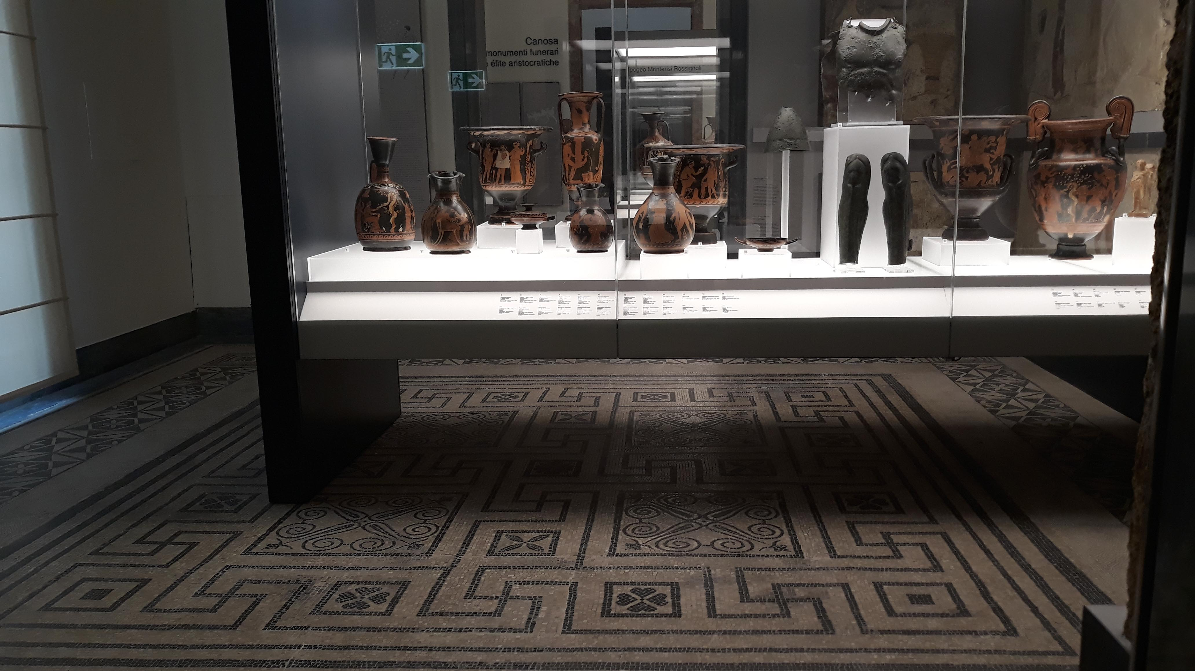
The National Archaeological Museum in Naples, Italy, combine objects featuring images of warfare with a breastplate and pair of greaves (shin-guards) in their themed Warfare case: different kinds of objects, same theme. (Nice floor too!)

Slide 34
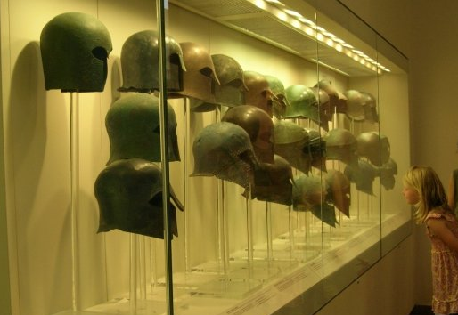
Grouping lots of the same type of object together is another way of helping people to appreciate what is distinctive about that object. The Archaeological Museum at Olympia, Greece, has grouped many of the same kind of helmet together. That way, you can see what is similar and what’s different in versions of the same helmet.
The height and grouping means that when you look at the case, it’s almost as if a group of people wearing the helmets are looking at you!

Slide 35
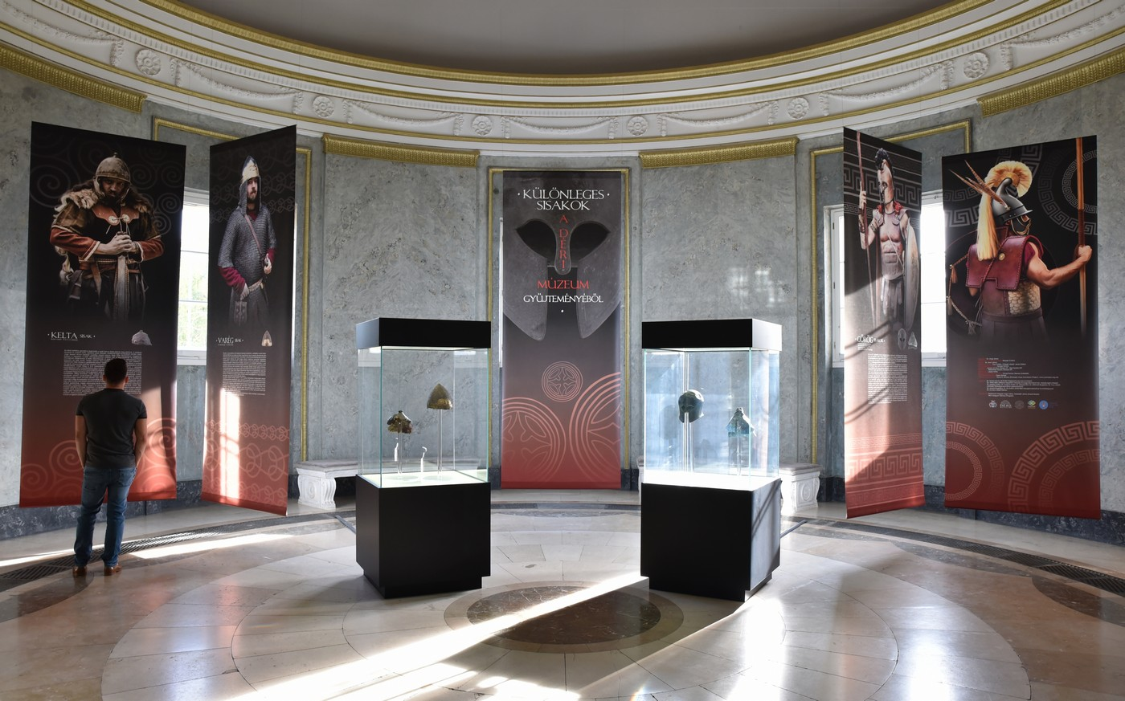
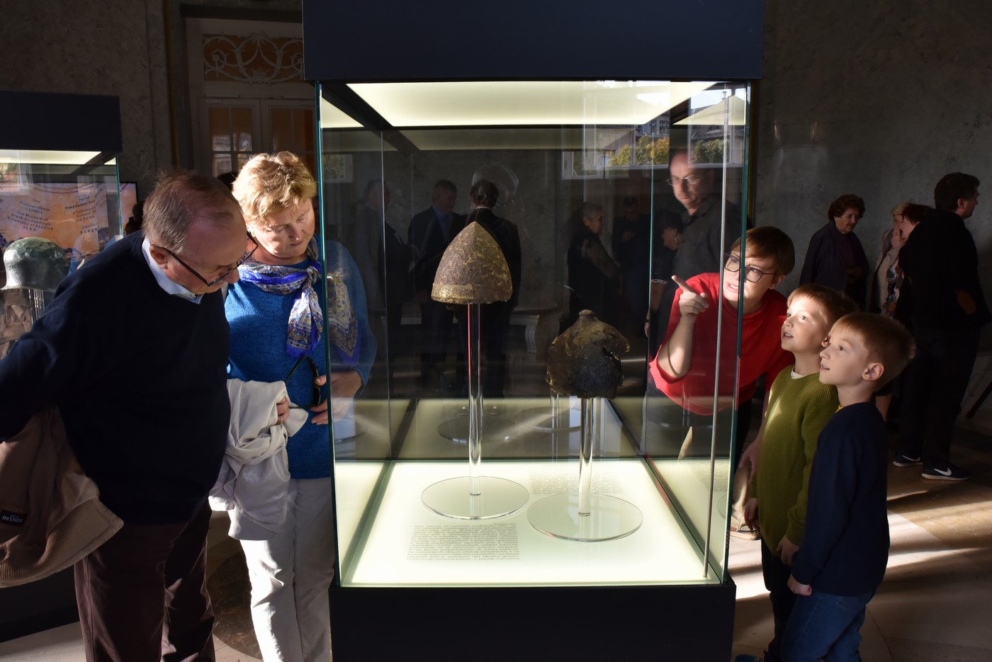
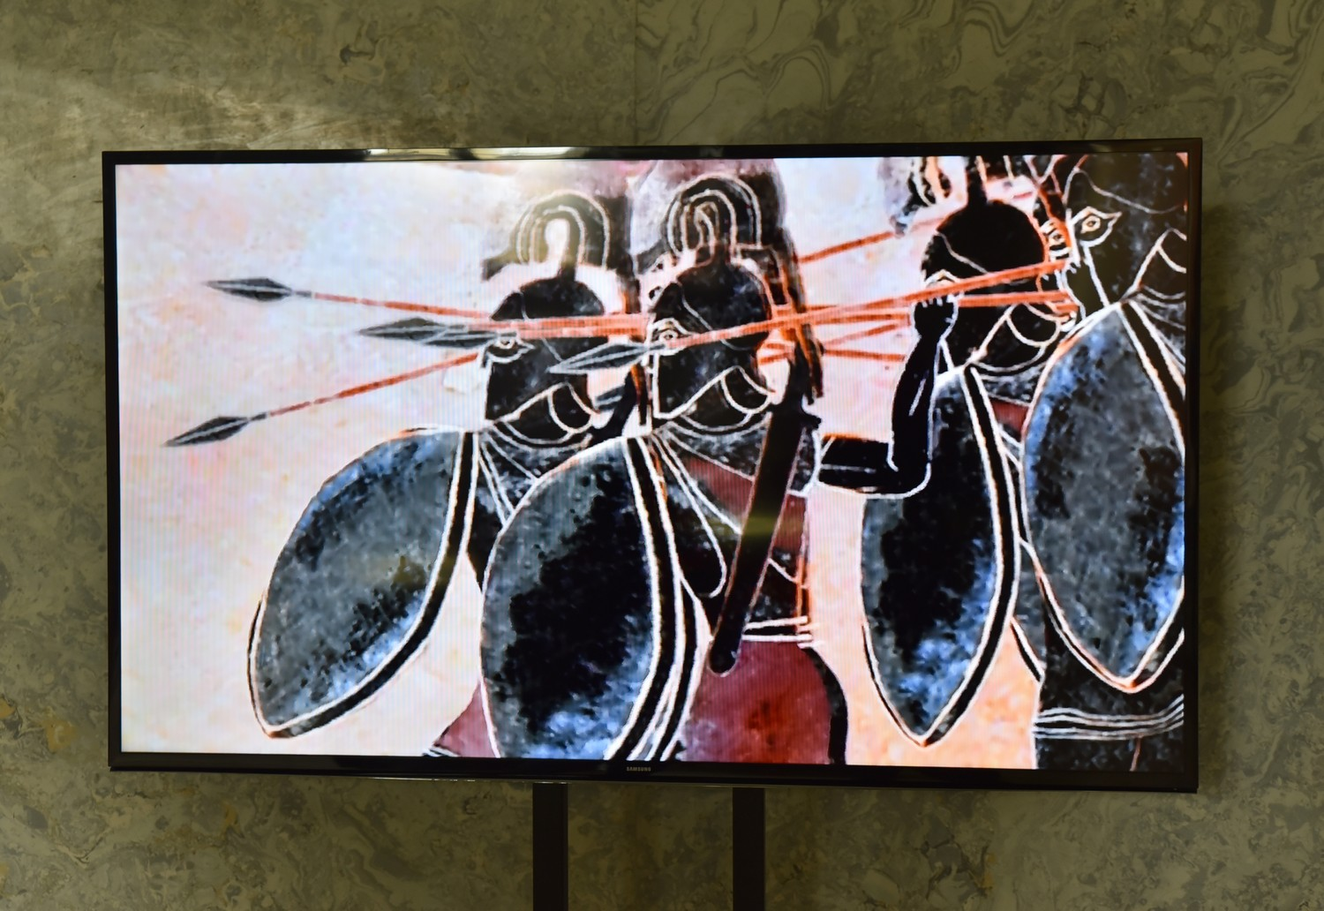
The Déri Museum in Hungary placed fewer helmets together. The theme is the same, the grouping of similar objects is the same, but fewer items places emphasis on the objects that are there.
The curator chose to display Panoply’s Hoplites! Greeks at War animation beside the helmets to show ancient helmets in use.

Slide 36
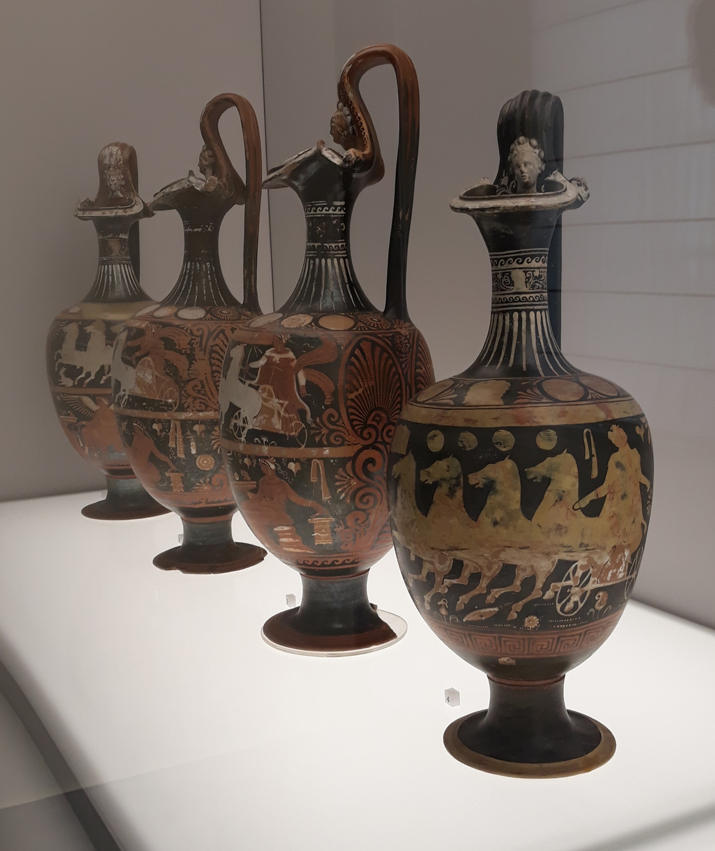
The National Archaeological Museum in Naples, Italy, placed these four vases together that are similar in size, style and period.
Seeing them together makes it clear that they are a type of object, not one-offs.

Slide 37
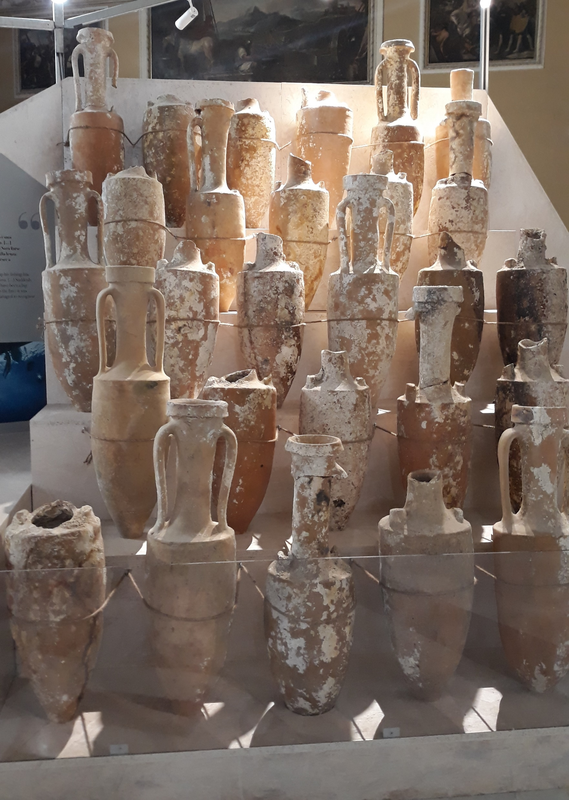
The same museum in Naples displays these amphoras together. They are of the same shape, style, and era, and they were all found in the sea.

Slide 38
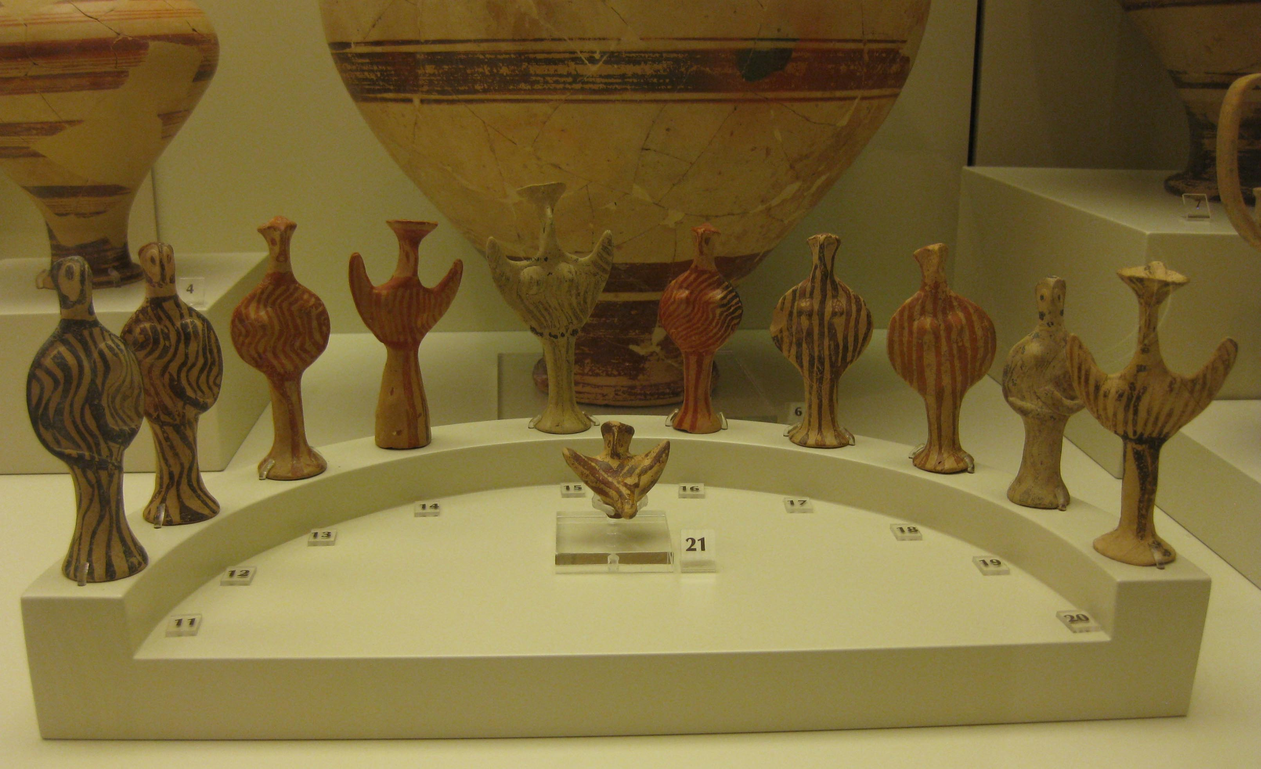
The Archaeological Museum of Mycenae, Greece, placed these female figures from the same era together in a semi-circle.
What effect do you think it has to have this repetition?

Slide 39
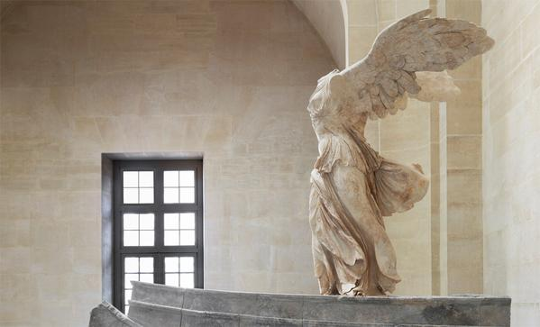
In contrast, the Louvre Museum in Paris, France, place a famous statue known as the Nike of Samothrace on its own at the end of a large hall. The walls around are very plain. All the attention falls on this one object.

Slide 40
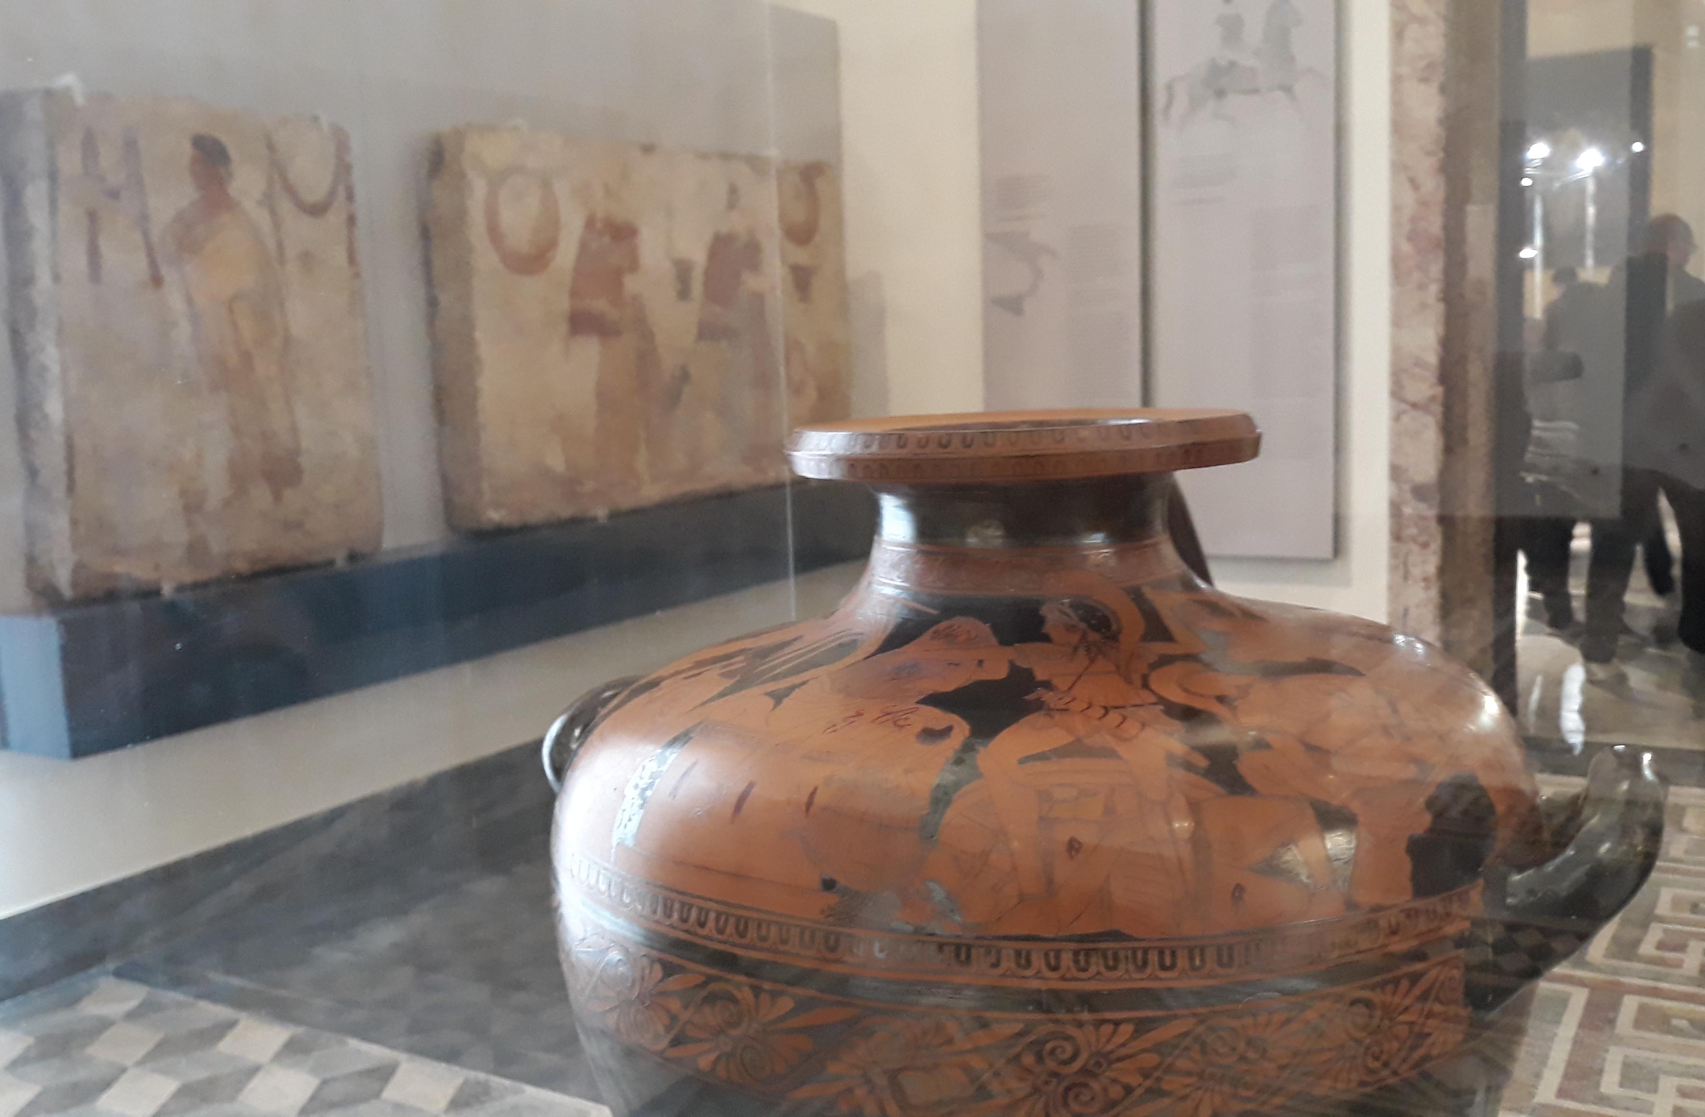
The National Archaeological Museum in Naples, Italy, placed this particularly famous vase by the Kleophrades Painter in its own case in the middle of a room.

Slide 41
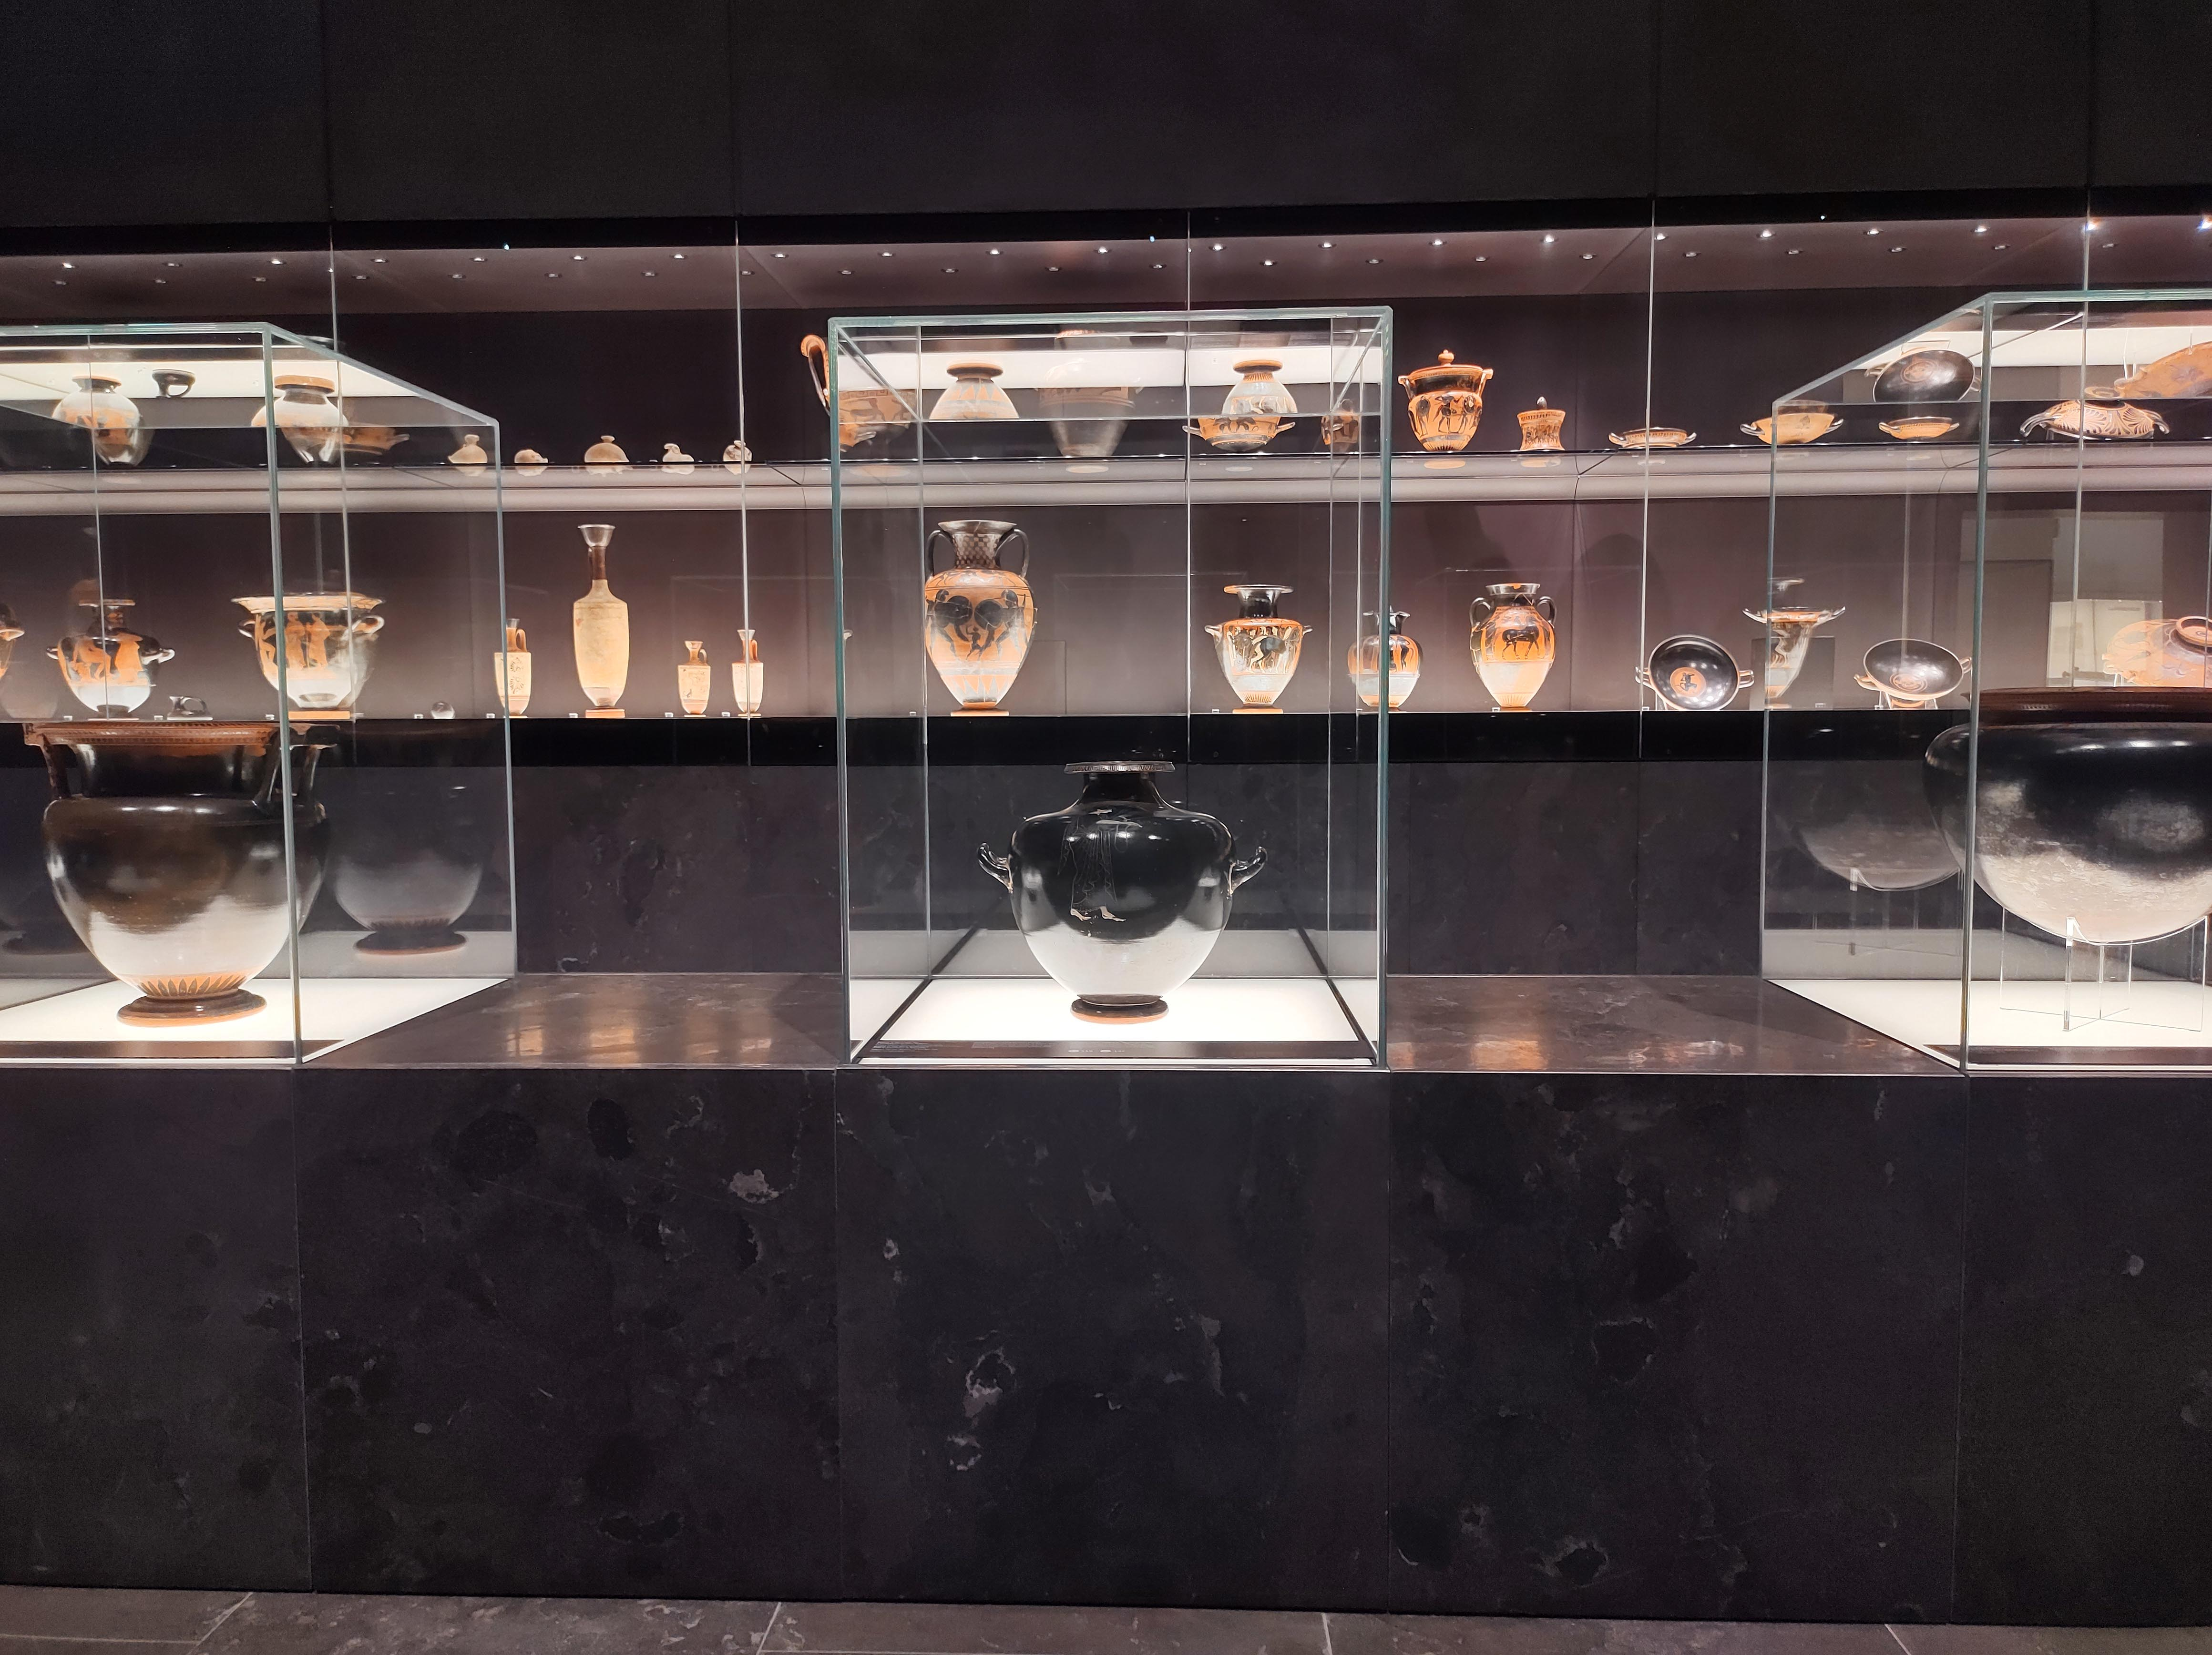
The National Museum in Warsaw, Poland, created a chronological room.
Vases go from older to newer as you walk from left to right in the room.
In the centre, they chose some vases to appear alone as ‘stars’.
The central vase in this image was used to make Panoply’s Sappho 44 animation.

Slide 42
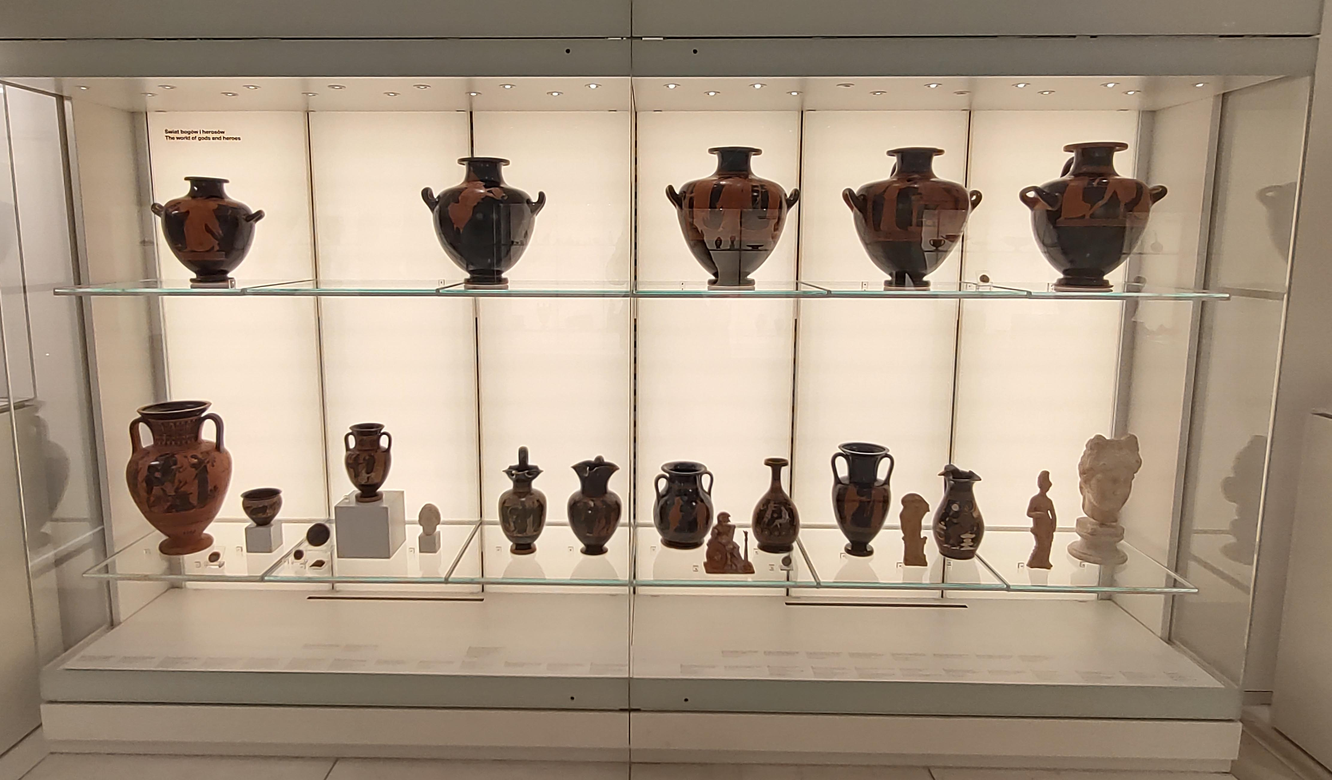
Other rooms in the National Museum in Warsaw are laid out by theme. The theme of this case is Mythology. Figures from several different myths can be seen on these vases. The vase on the bottom left was used to create Panoply’s Heracles and the Erymanthian Boar animation.

Slide 43
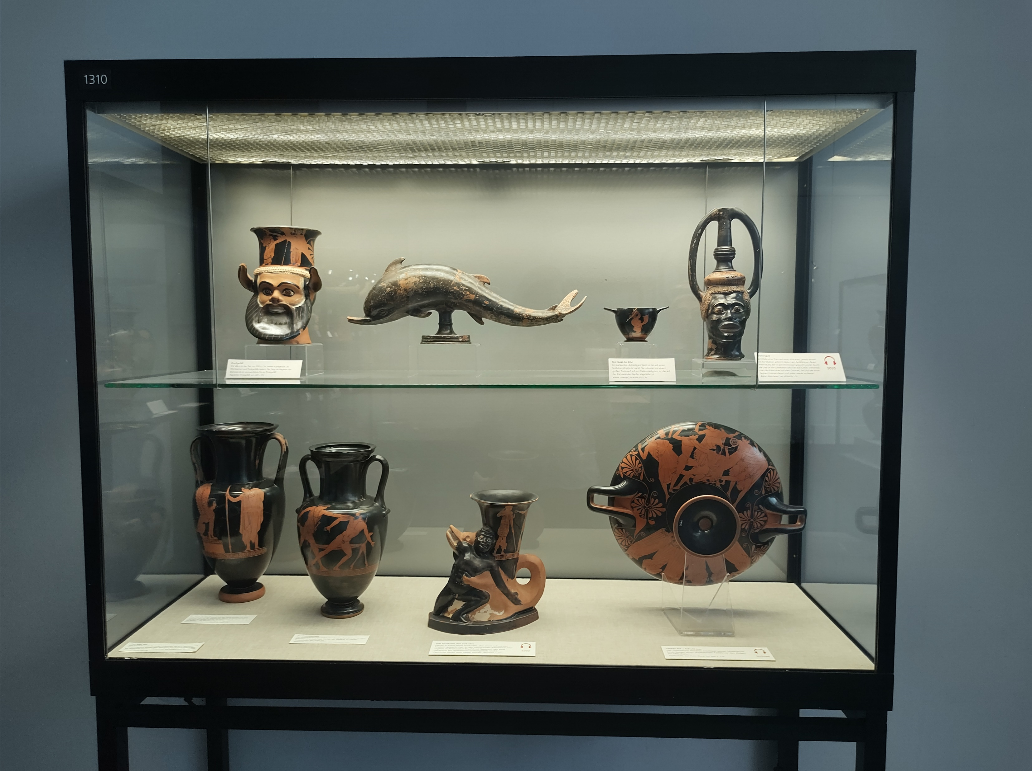
Where an object is positioned and what its case is like affects how it is seen.
Seen from the front, this case in the Museum of Antiquities in Munich, Germany features a vase in the shape of a Black African man’s head…

Slide 44
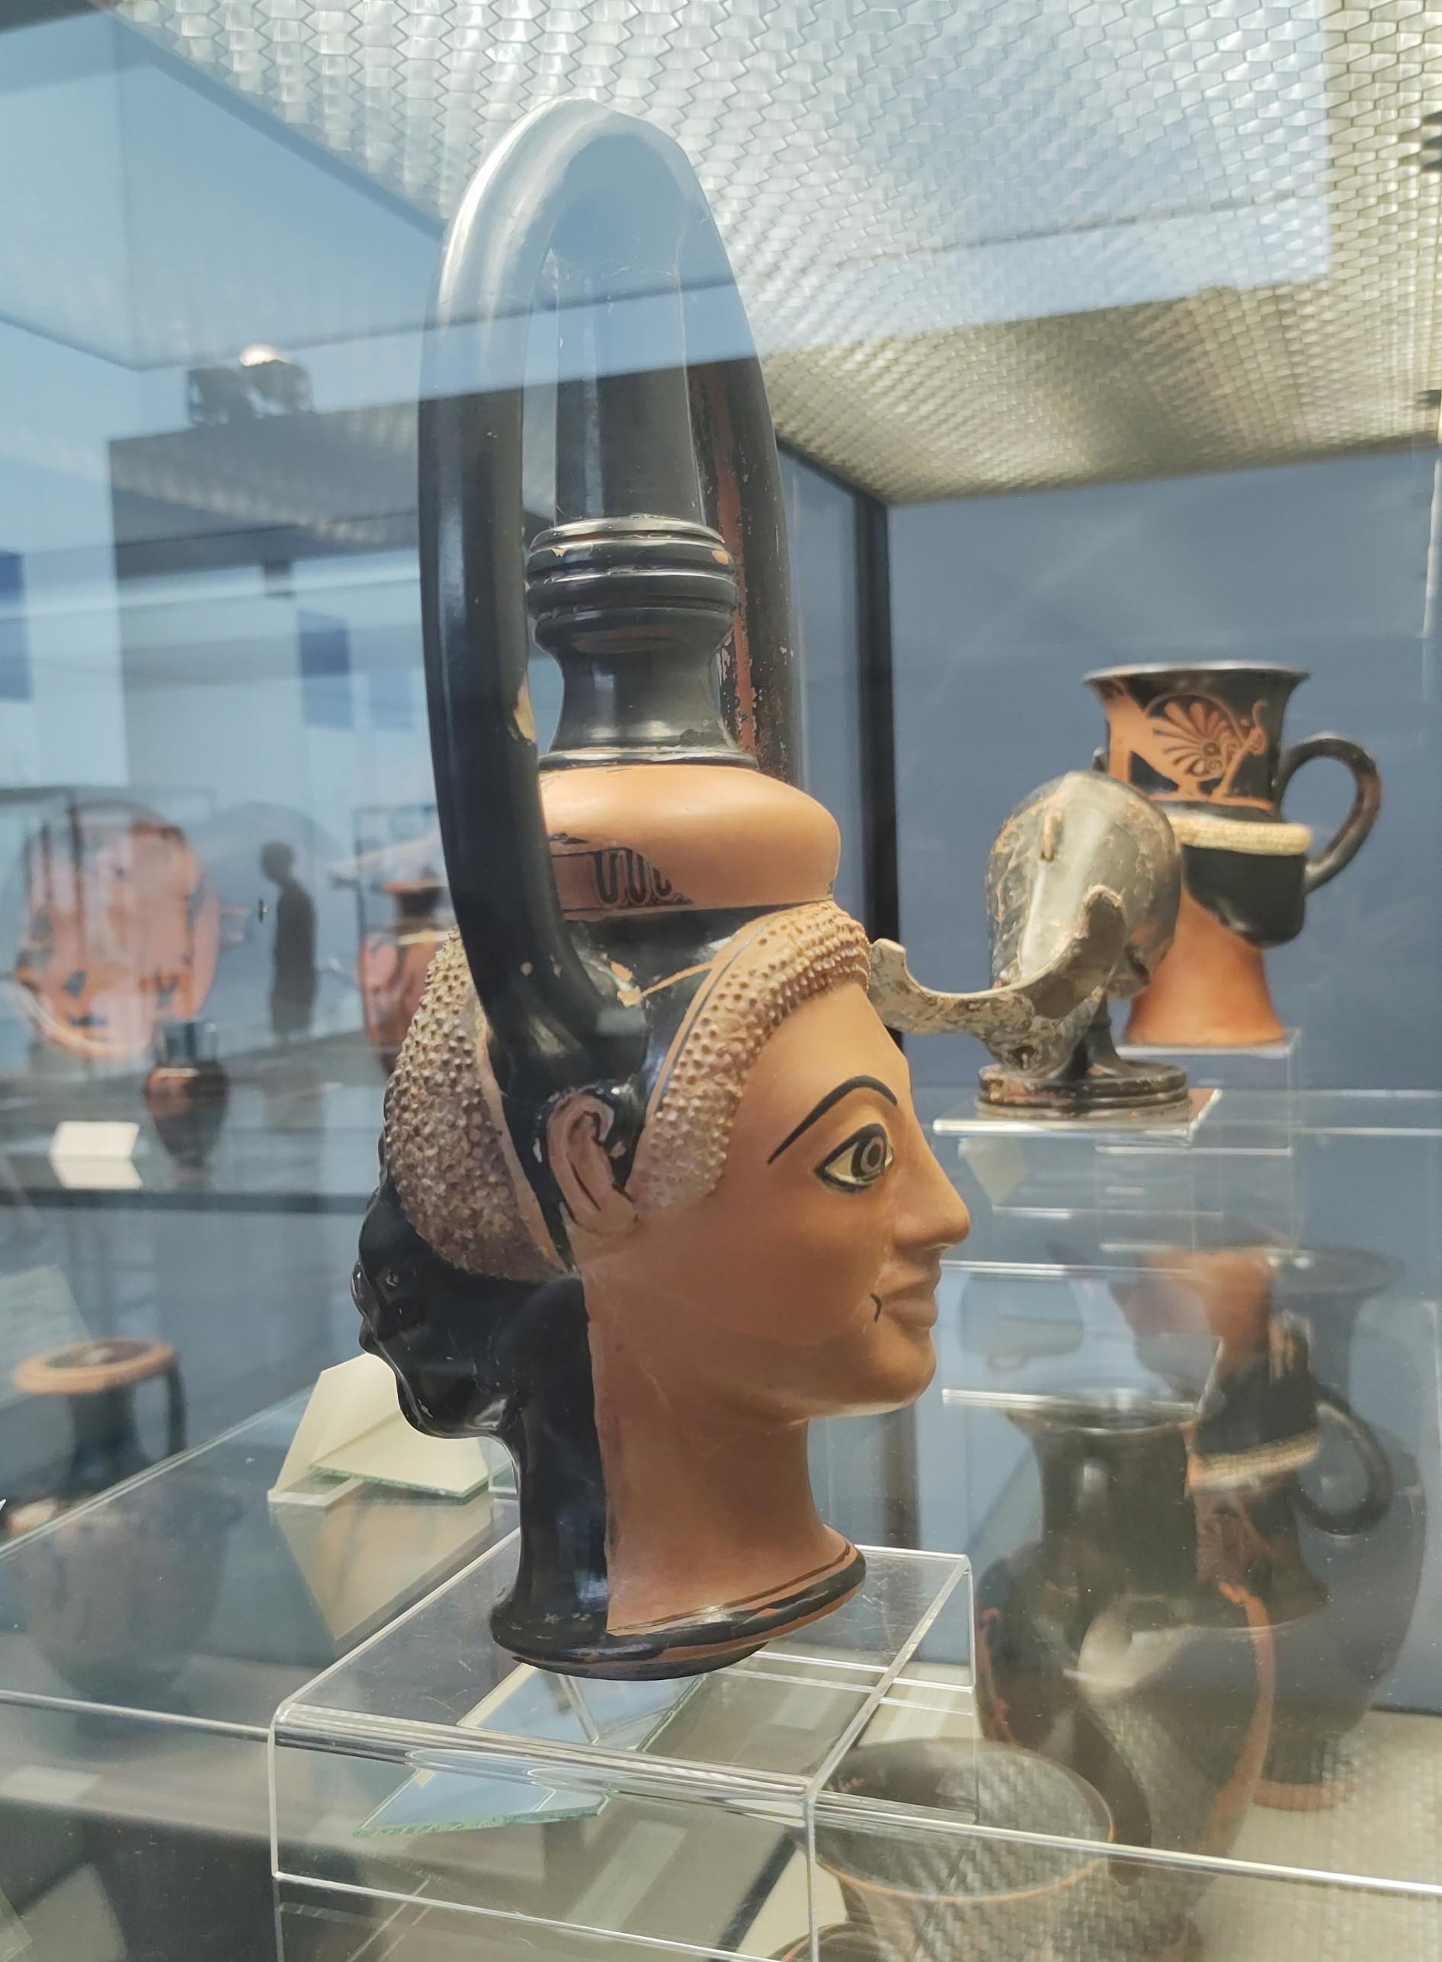
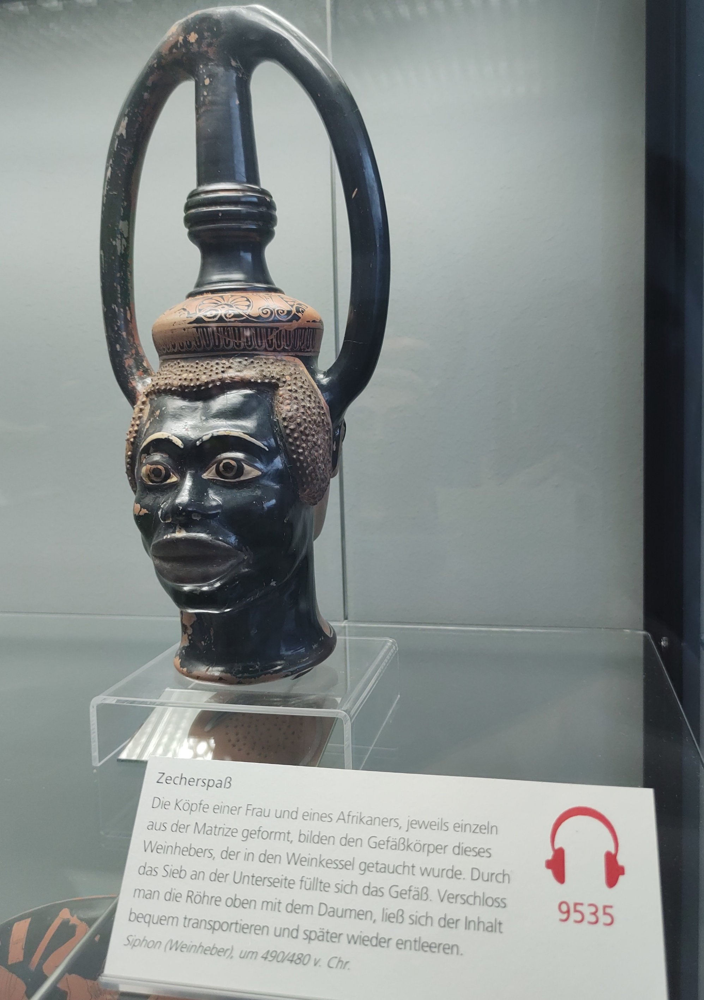
…When seen from the side of the case, visitors can see that it’s a Janiform vase (two heads, after Janus), with a Greek head forming the second side.
For more on Africans in ancient Greek pottery, see this interview on the Panoply Blog.

Slide 45
What will you do with the background around the objects?

Slide 46
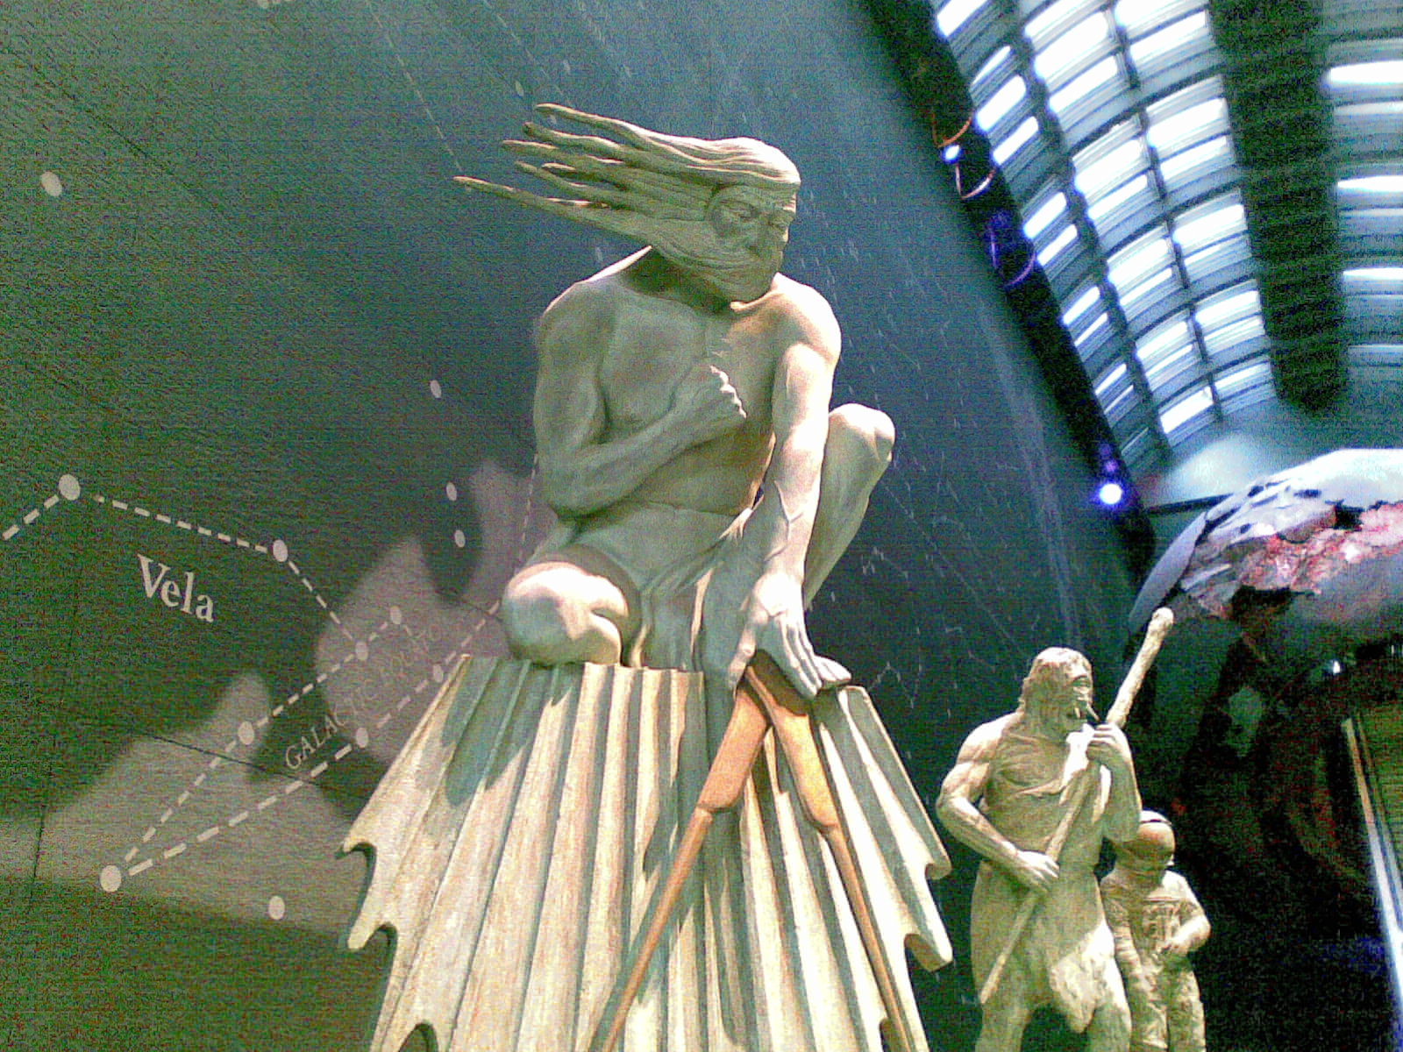
Sometimes a curator might like the theme of a case or a room to extend onto the walls of the room, as we see here in the Natural History Museum, London.

Slide 47
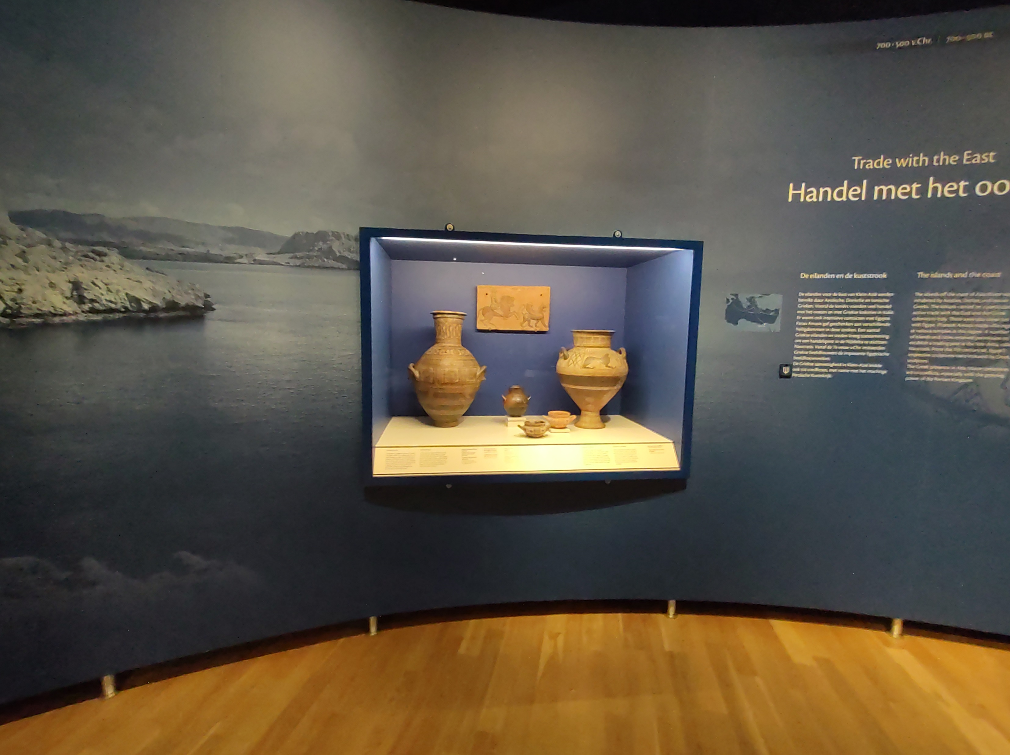
The National Museum of Antiquities in Leiden, The Netherlands, used a large photograph on the wall to give a sense of the landscape where these objects came from. It also adds colour to the room.

Slide 48
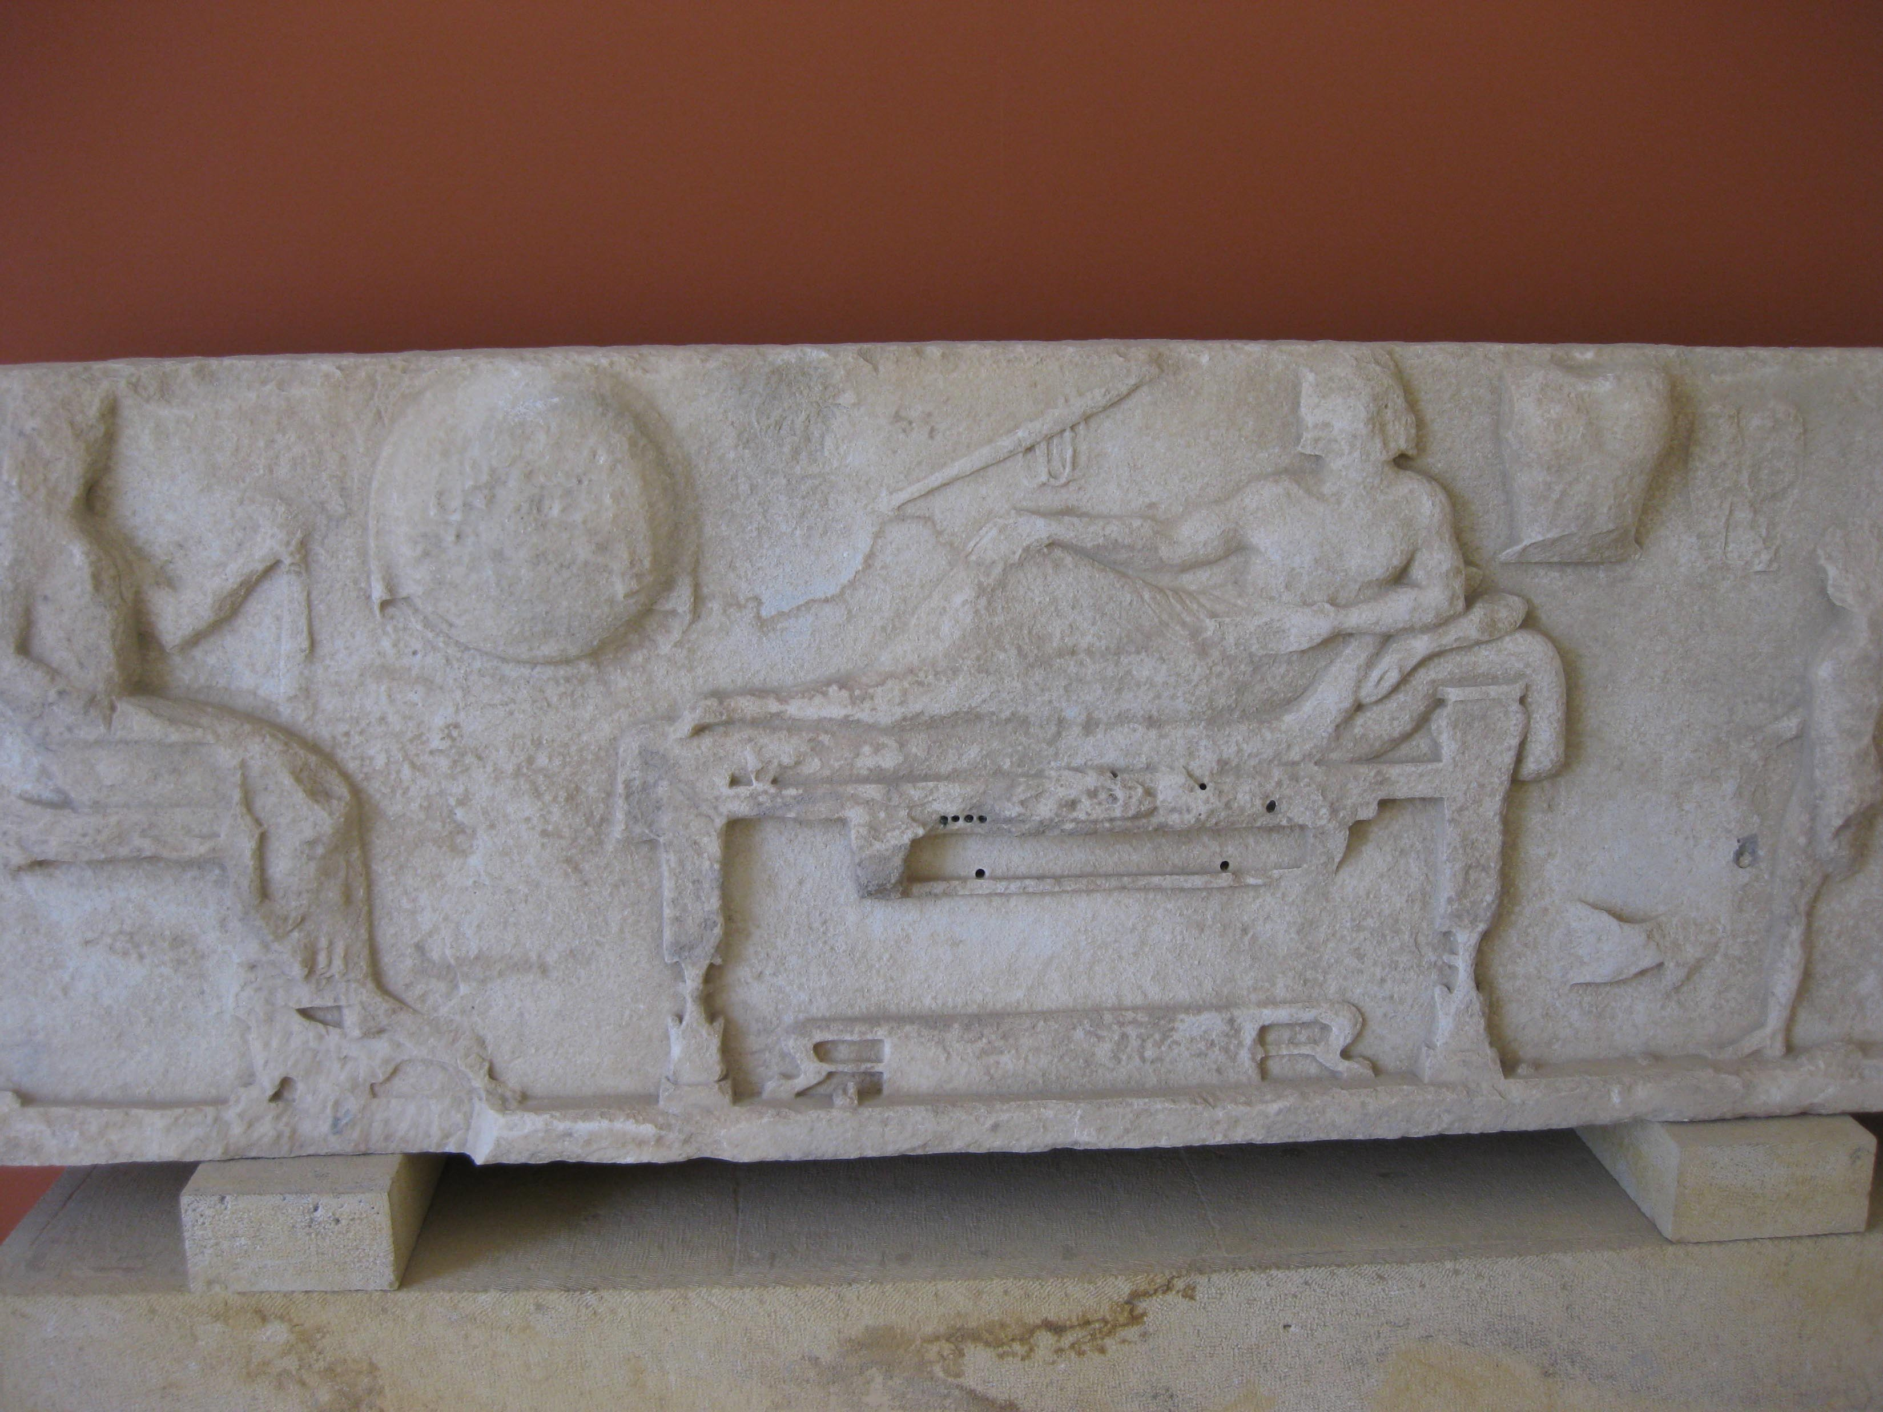
Sometimes even just a striking colour might be chosen to serve as a backdrop that makes an object stand out, as in this use of red to highlight a white object in The Archaeological Museum of Paros, Greece.

Slide 49
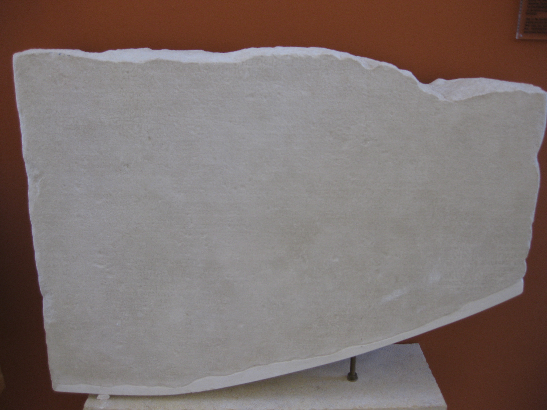
The Archaeological Museum of Paros also used red behind this white inscription – words carved into stone. It would normally be the curator’s decision regarding whether the text on this object would be shown on an easier to read label and whether it should be translated into other languages.

Slide 50
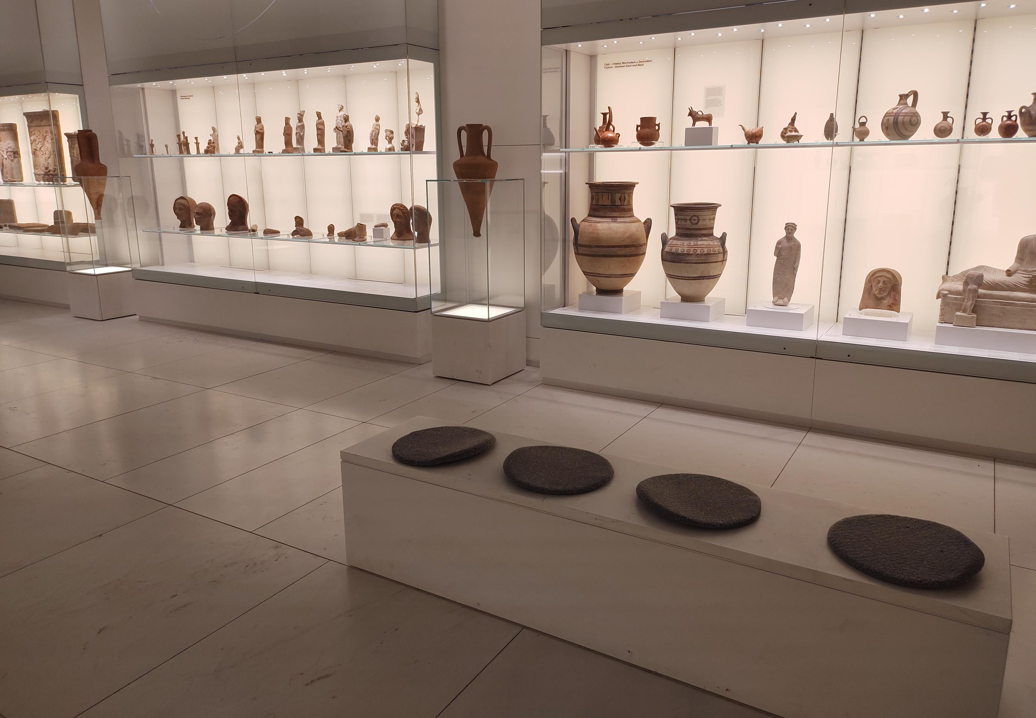
Don’t forget the seats!
It might be a curator’s job to consider other things in a museum, such as where to put seats or benches for people who cannot stand up for very long, or who might like to look at an object for a long time.

Slide 51
Will you add any extra things to accompany the objects?
Some common items are:
Illustrations
Videos and Animations
Replicas that visitors can touch
Maps
Timelines
Games
Modern Artworks

Slide 52
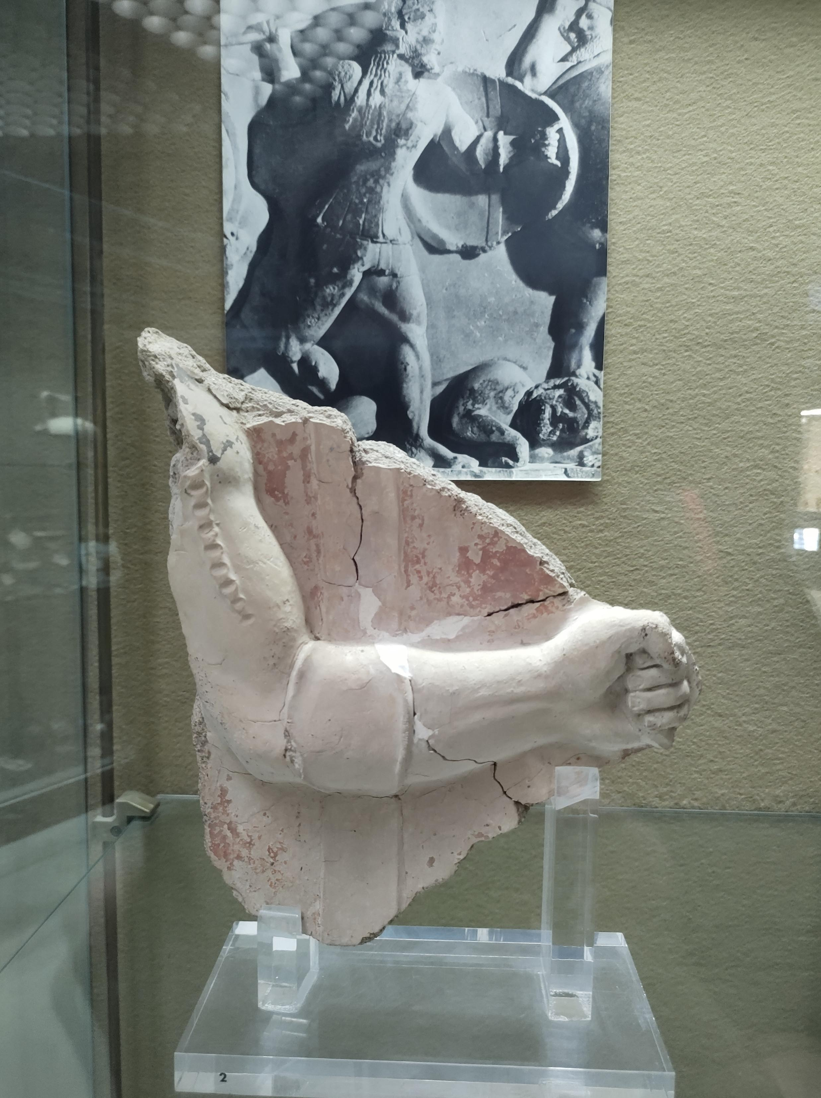
The Regional Archaeological Museum of Syracuse, Sicily, Italy, used a photograph of an ancient object (a frieze) to show what their object depicts (a shield band).

Slide 53
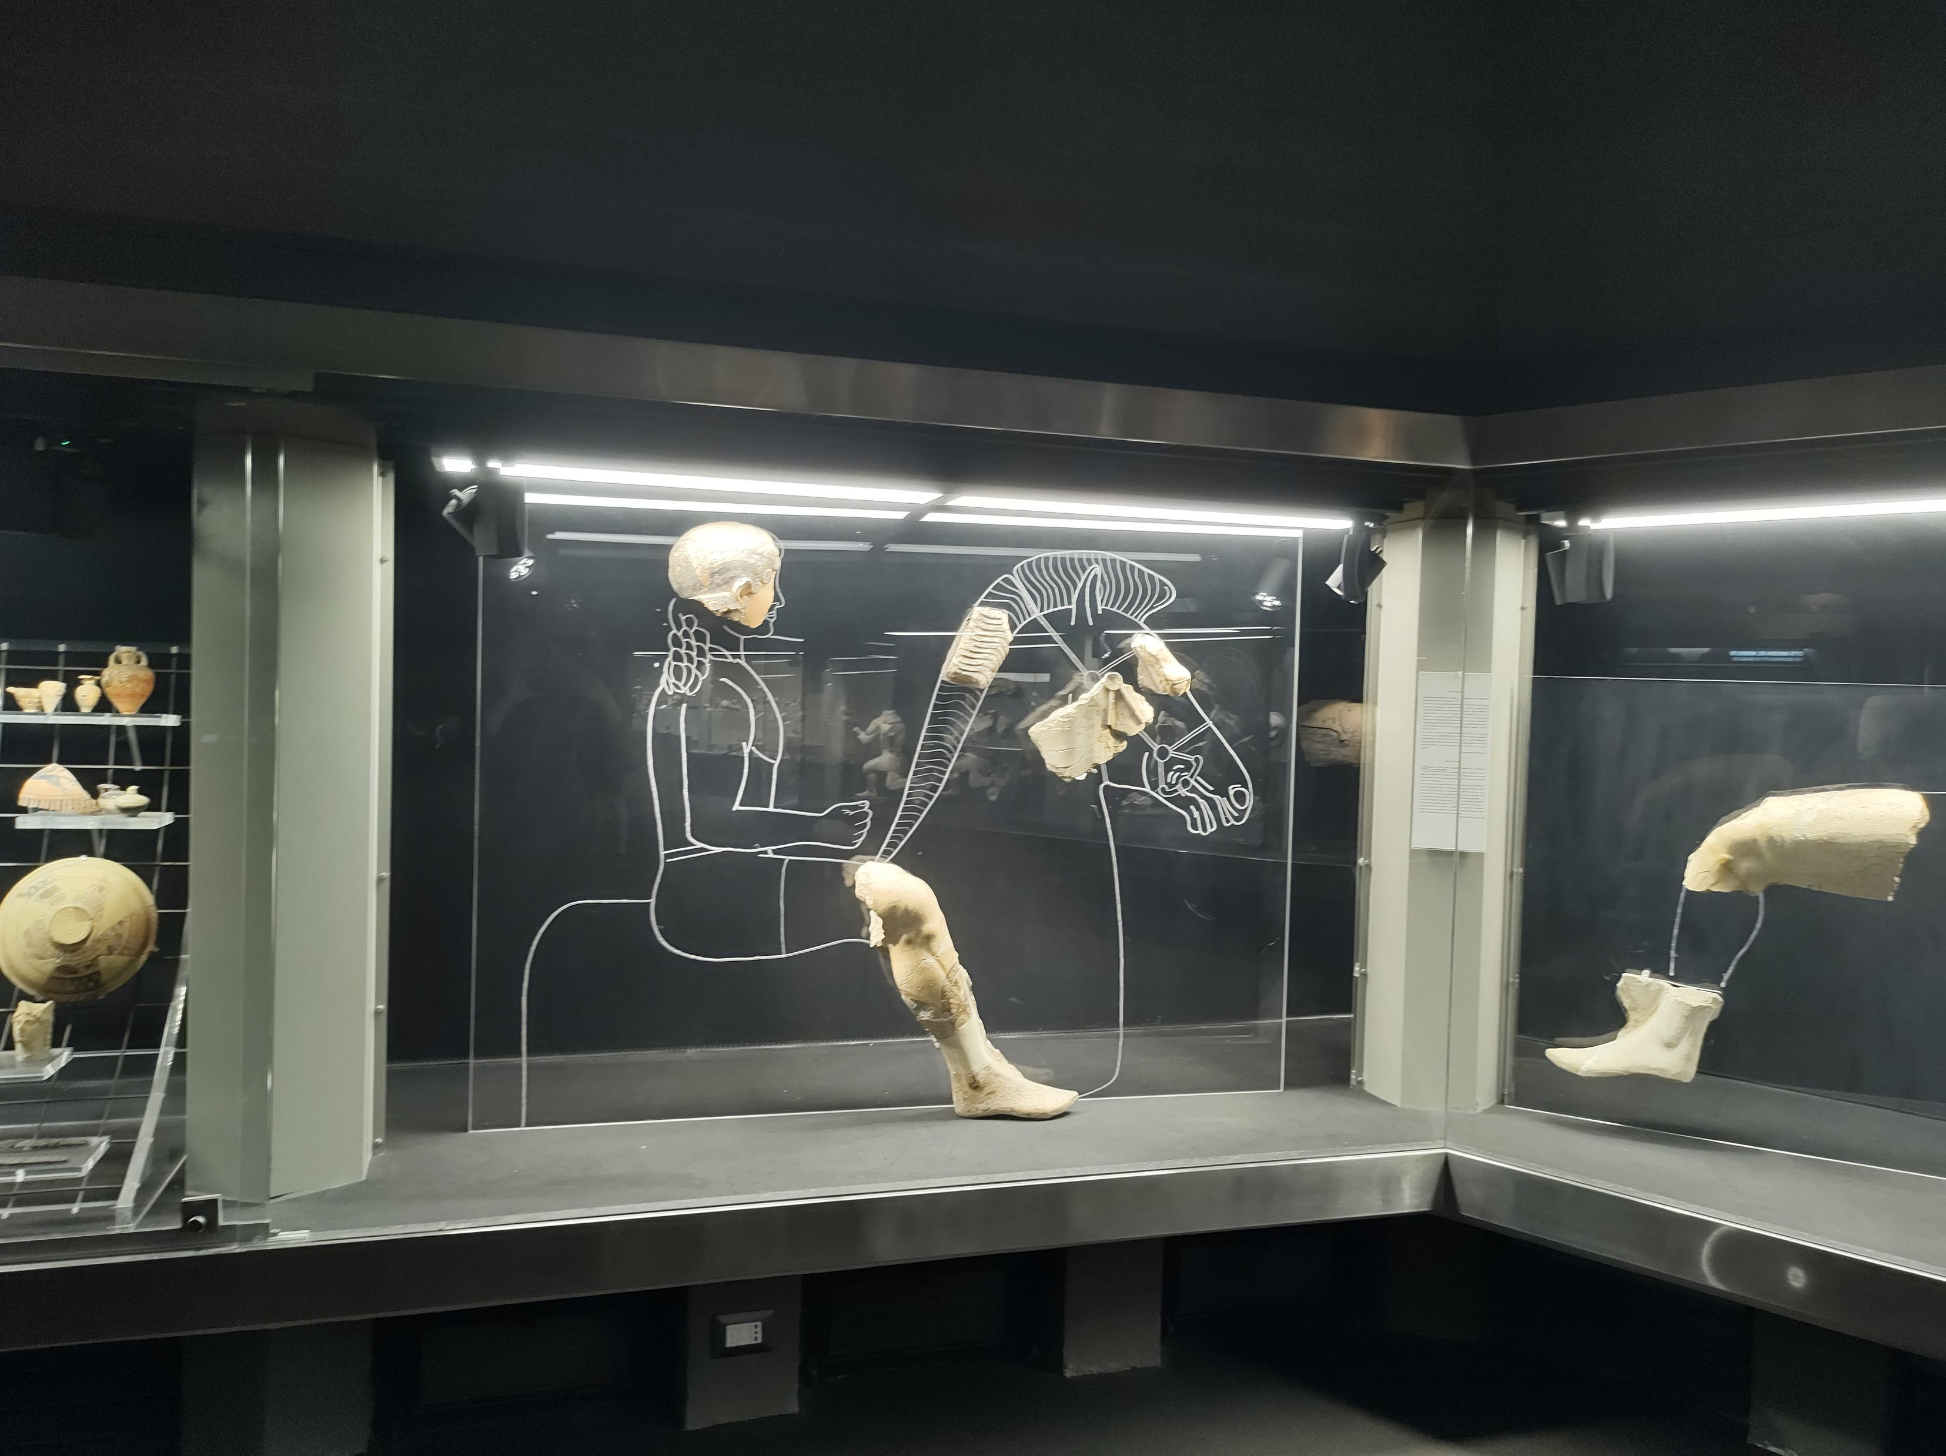
The same museum used these simple reconstruction illustrations to show how the broken parts of this object would once have fitted together.

Slide 54
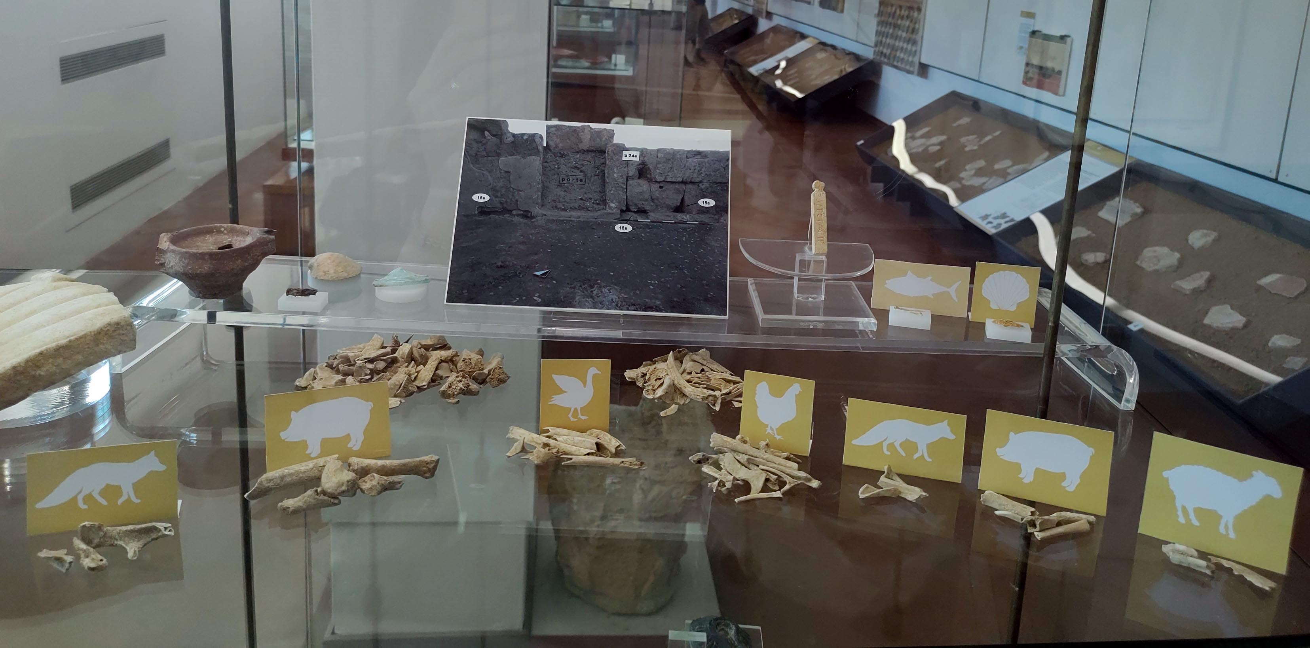
The Pietro Griffo Regional Archaeology Museum in Agrigento, Sicily, Italy, used these simple images of animals to show which animals these bones came from.

Slide 55
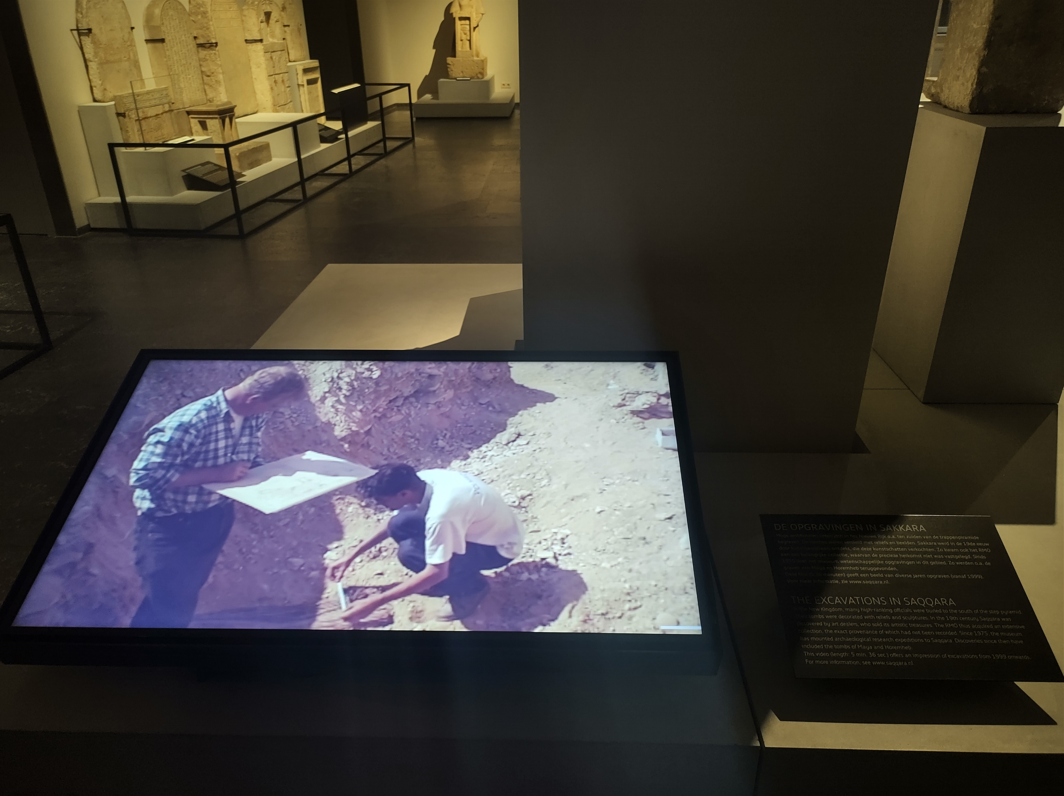
Curators at The National Museum of Antiquities in Leiden, The Netherlands, included this video of an excavation where some of their objects found.

Slide 56
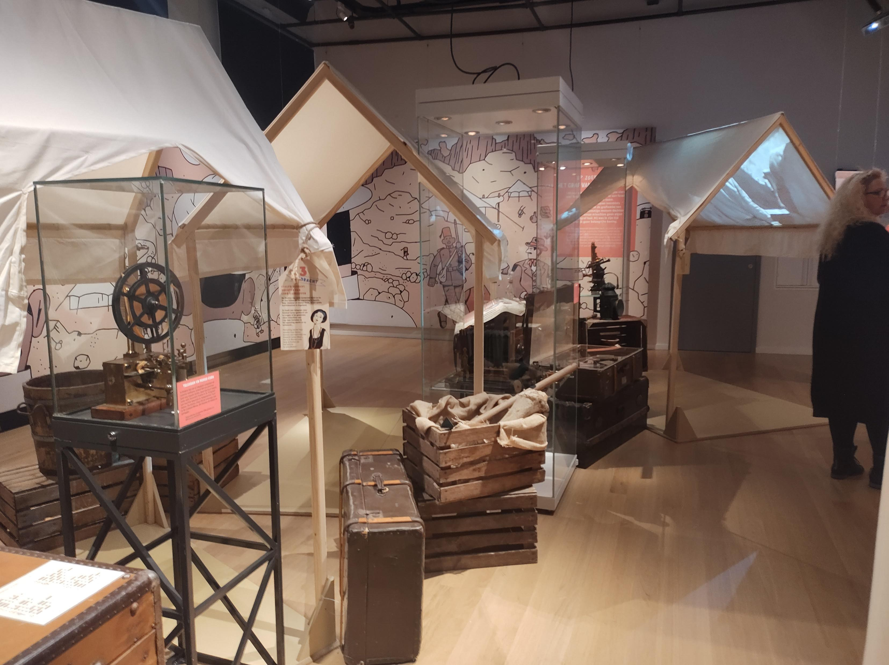
The same museum added this playful reconstruction of an excavation camp that visitors could go inside.

Slide 57
You may recall this case from the Ure Museum, UK, that includes a section of reconstructed excavation alongside the artefacts, showing above and below ground.

Slide 58
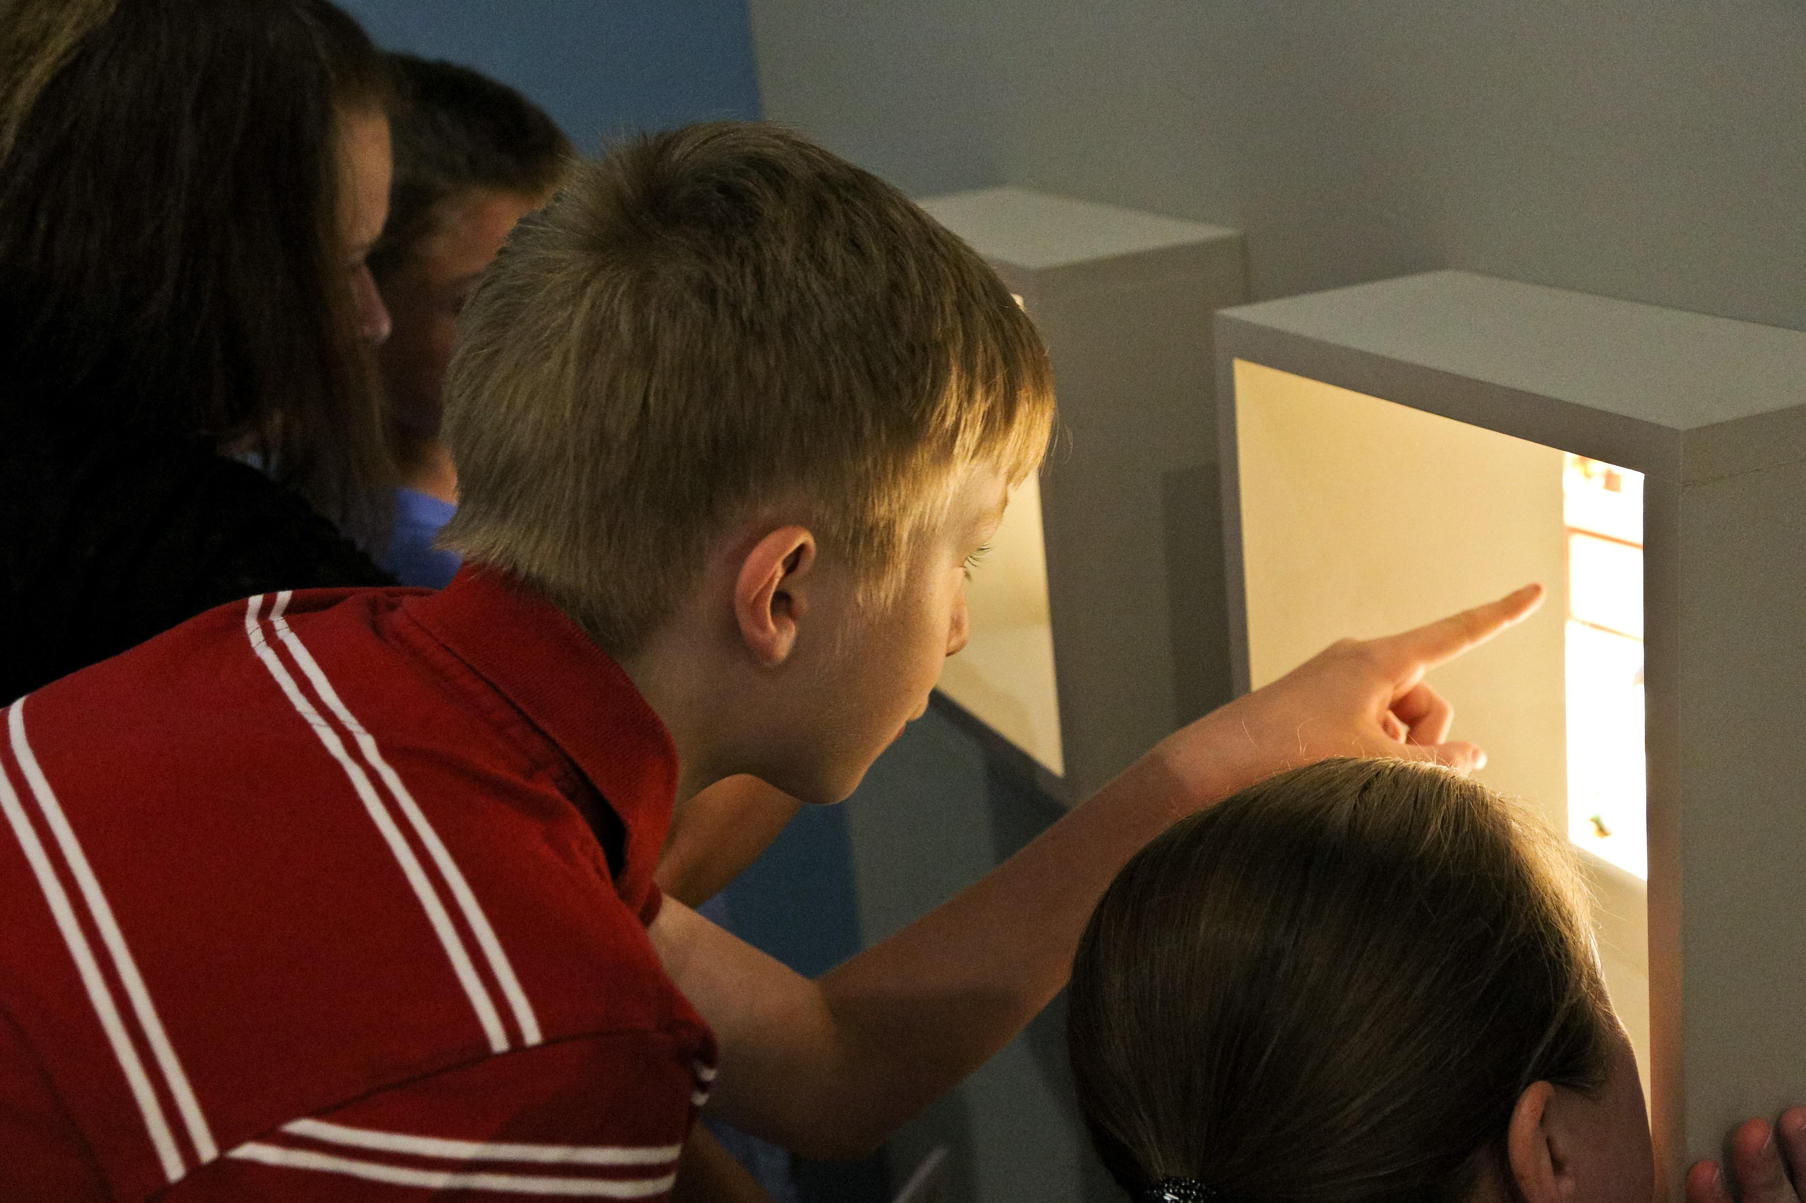
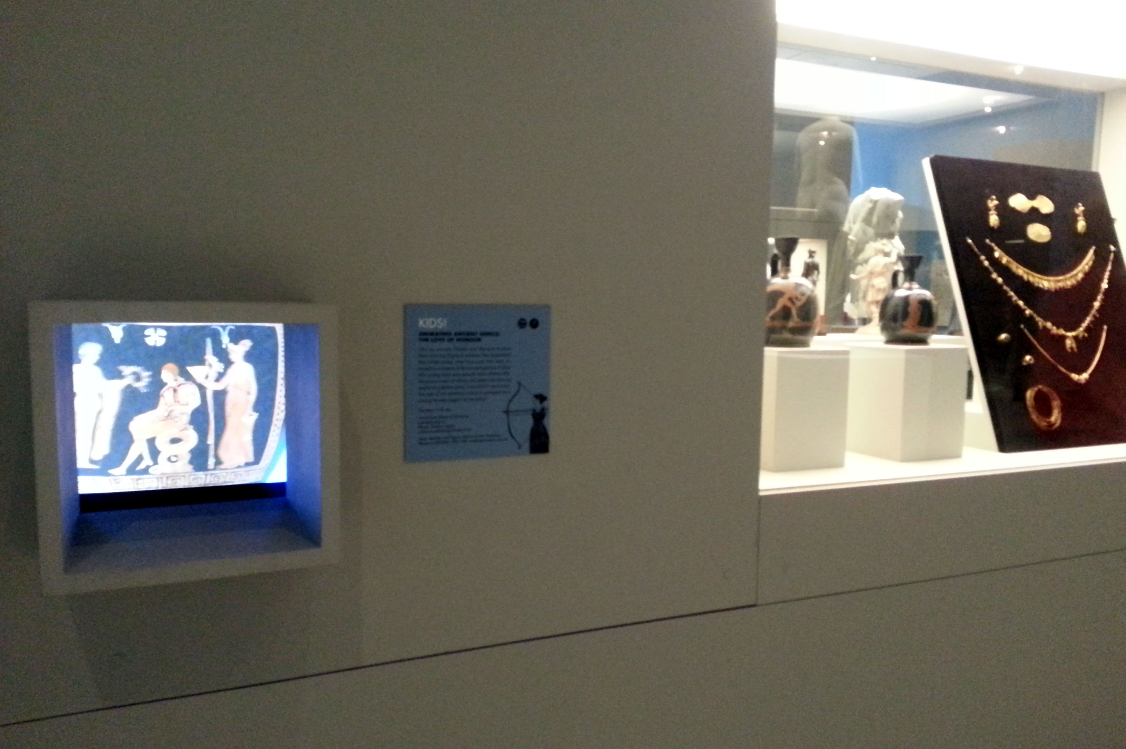
The Winnipeg Art Gallery, Canada, showed Panoply vase animations in viewing boxes between the artefacts.

Slide 59
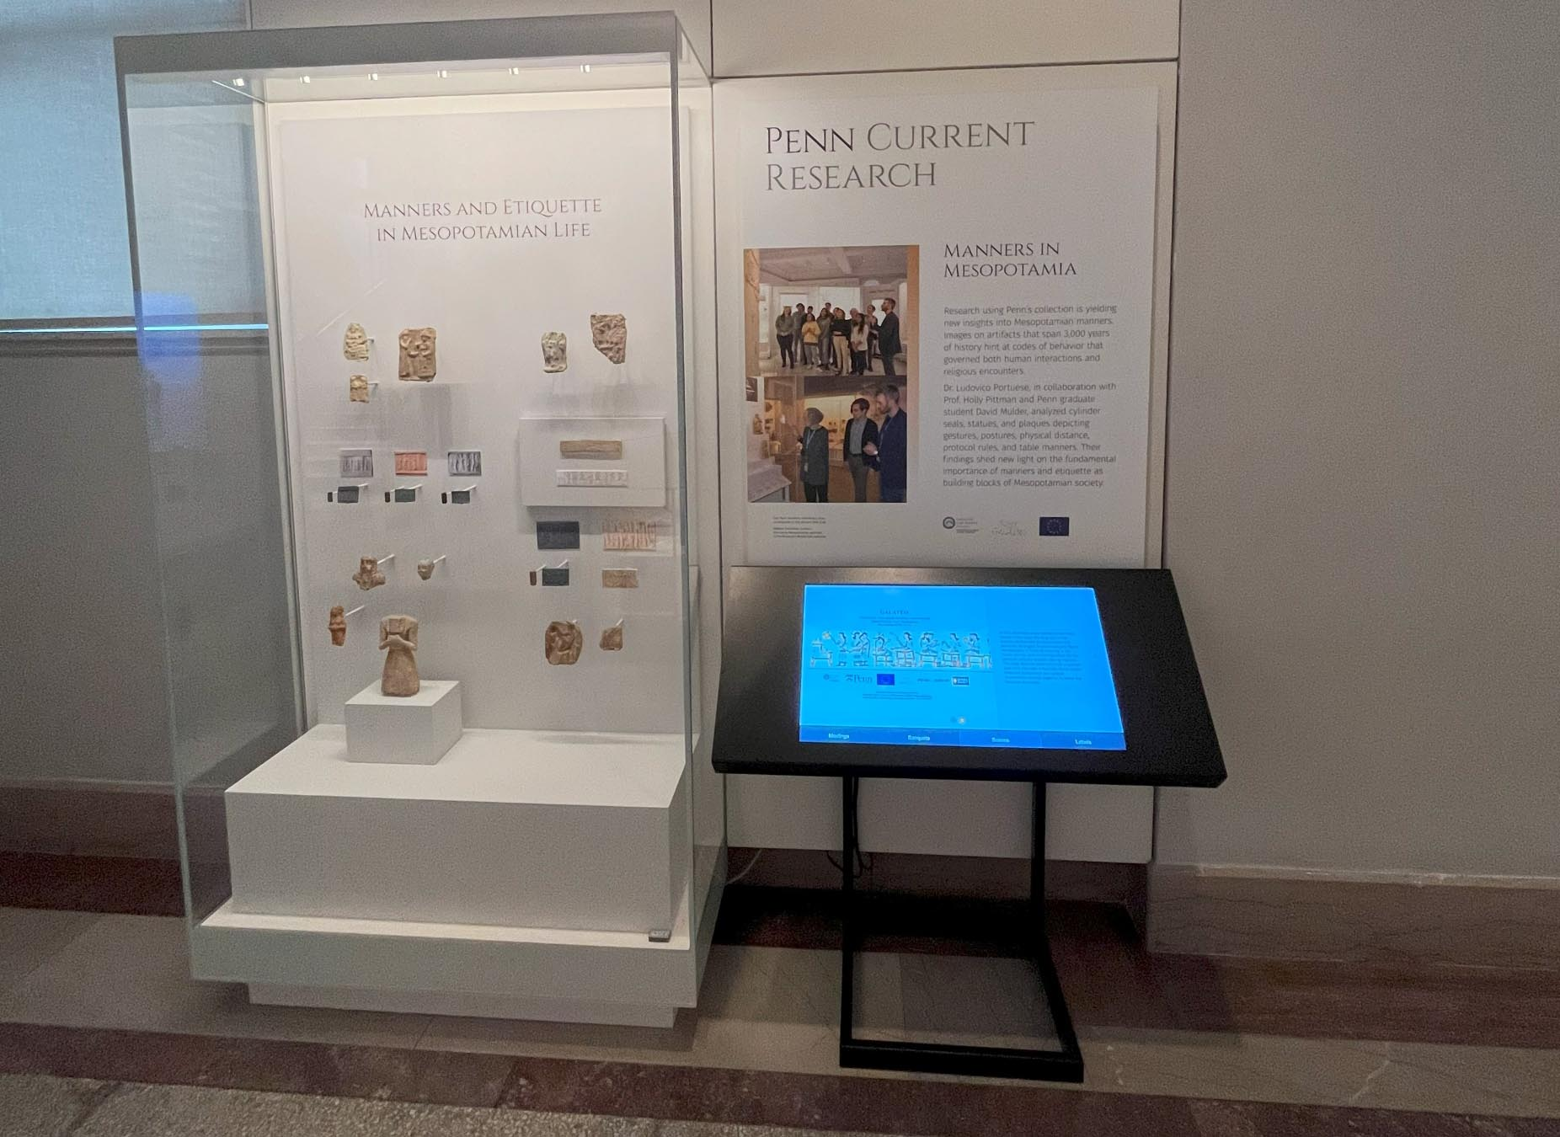
The Penn Museum, USA, used a large screen to show a Panoply animation of one of their ivory artefacts along with other information from the GALATEO Project.

Slide 60
The same exhibition about ancient Mesopotamia includes illustrations
of objects that have scenes which are a little hard to make out.
There is more about this exhibition here on the Panoply Blog.

Slide 61
Amongst their objects, The Swiss Museum of Games, Switzerland, included a large information panel, projections on the wall, and a Panoply animation made from a vase with a game being played. Just out of view are boardgames for visitors to play.

Slide 62
The same project, Locus Ludi, included boardgames that visitors could play in their exhibition at the Roman Museum in Vallon, Switzerland.

Slide 63
The Islanders exhibition at the Fitzwilliam Museum, Cambridge, UK, included a giant timeline painted on the wall of the gallery.
Although it is a bit hard to read here, the right hand side includes time periods relating to the exhibition about ancient Greece, while the left hand side includes historical events happening at the same times in other parts of the world.

Slide 64
The British Museum, London, included this 3D reconstruction of the ancient sanctuary of Zeus at Olympia in Greece. An addition like this might be short-term, to go with a particular exhibition, or permanent (which really means long-term rather than forever – perhaps 10 years).

Slide 65
The British Museum grouped together these similar statuettes from ancient Greece and two spear heads from the same time and place.
They also added an image of some modern geometric style art that has an affinity – a likeness – to the ancient figurines.
Does having the modern art there influence how you see the ancient object, or the modern object, or not at all?
(Also notice how they have positioned the figurines upright on clear stands).

Slide 66
The Museum of Classical Archaeology in Cambridge, UK, often hosts modern art exhibitions in which contemporary artworks sit alongside Victorian casts of ancient sculpture. Curators consider what combinations would be interesting, and work with artists to bring the collaboration together.

Slide 67
The Glyptothek in Munich, Germany, presents modern art alongside ancient sculpture. The metal leaf-like sculpture is from an exhibition of work by Santiago Calatrava called ‘Beyond Hellas’. ‘Hellas’ is the Greek name for Greece.
What do you think ‘Beyond Hellas’ means here?

Slide 68
The Museum of Classical Archaeology, Cambridge, hosts occasional one-off events in which visitors can see the artworks displayed in different lights.
This piece is a Victorian cast of a marble sculpture called the Farnese Hercules, which is a Roman copy of a Greek metal sculpture.
Do different lights make you see an object in a different way, or notice different things about it?

Slide 69
The Farnese Hercules is now housed in the Archaeological Museum in Naples, Italy.
Curators have positioned it to make it easy to see all the way around it (known as ‘in the round’), so that visitors can easily see the apples that Hercules holds behind his back.

Slide 70
The J. Paul Getty Museum, USA, exhibited objects from different cultures together in a temporary exhibition called Picture Worlds. Pottery from the ancient Greek, Mayan, and Moche cultures were displayed side by side.

Slide 71
Making choices.
You are a curator.
You have this vase from ancient Greece in the 6th century BCE.
It shows Herakles (known to Romans as Hercules) bringing the Erymanthian Boar back to King Eurystheus after capturing it.
How will you display it?
For much more on the vase, including a Panoply animation and mini-documentary,
click here.

Slide 72
Would you like visitors to be able to see the back of the vase?
You can see the scene on the right, depicting a band of warriors.

Slide 73
Would you display the vase in a ‘Heracles’ theme case alongside other vases showing Heracles, such as this one on the left depicting him fighting a three-bodied Giant?

Slide 74
Perhaps you would prefer to create an ‘Animal’ or ‘Boar’ themed display showing other images of boars.

Slide 75
Perhaps you would prefer to go chronological and group together vases from different eras?

Slide 76
Perhaps you would go with something altogether different.

Slide 77
What can go wrong?
Not everyone agrees about what makes a good exhibition. Perhaps you can think of exhibitions you’ve enjoyed or one’s you thought were less successful. What did you like or dislike about them?
Amongst the many things that can go wrong, are:
Writing on the labels is too small to read, with too much information or not enough information.
Hard to tell what the objects are or what they were for.
Hard to see how the objects relate to each other.
Light in the gallery is too dark or too bright.
Unclear which order to look at the objects in, or if there is an order.
No access for wheelchair users; no chairs.
Too busy, making it hard to see the objects or read the labels.
Exhibition clashes with another museum doing a similar event.
Exhibition too expensive to put on, or too expensive to attend.
Poor marketing – no one knows it’s on.
What else could go wrong? How could you prevent these challenges?

Slide 78
Have fun planning your own exhibition!
Visit the lesson-plan chapters
‘Curation Challenge’ by Jennie Thornber
and
‘Displaying Animations’
by Louise Maguire,
in the Open Access volume
Teaching Ancient Greece. Lesson Plans, Vase Animations, and Resources,
edited by Sonya Nevin,
for more ideas about planning your own exhibition.

Slide 79
This PowerPoint was made by Dr Sonya Nevin of the Panoply Vase Animation Project, for the ERC-funded project
Our Mythical Childhood: http://www.omc.obta.al.uw.edu.pl/
Feel free to use this PowerPoint for educational purposes, including editing it.
Please do not post it online. Share its url if you would like to share it.
The PowerPoint can be downloaded from:
https://www.panoply.org.uk/further-resources

