Slide 1
Heracles and the Erymanthian Boar

Slide 2
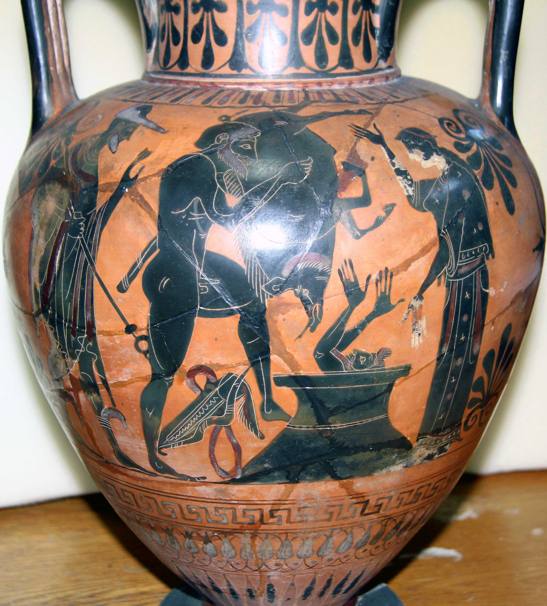
Heracles and the Erymanthian Boar amphora
(198042 MNW)

Slide 3
Black figure vases were created by applying black slip onto the red clay. Tools could be used to mark extra details, and one or two other slips provide extra colour – white and ‘deliberate red’.

Slide 5
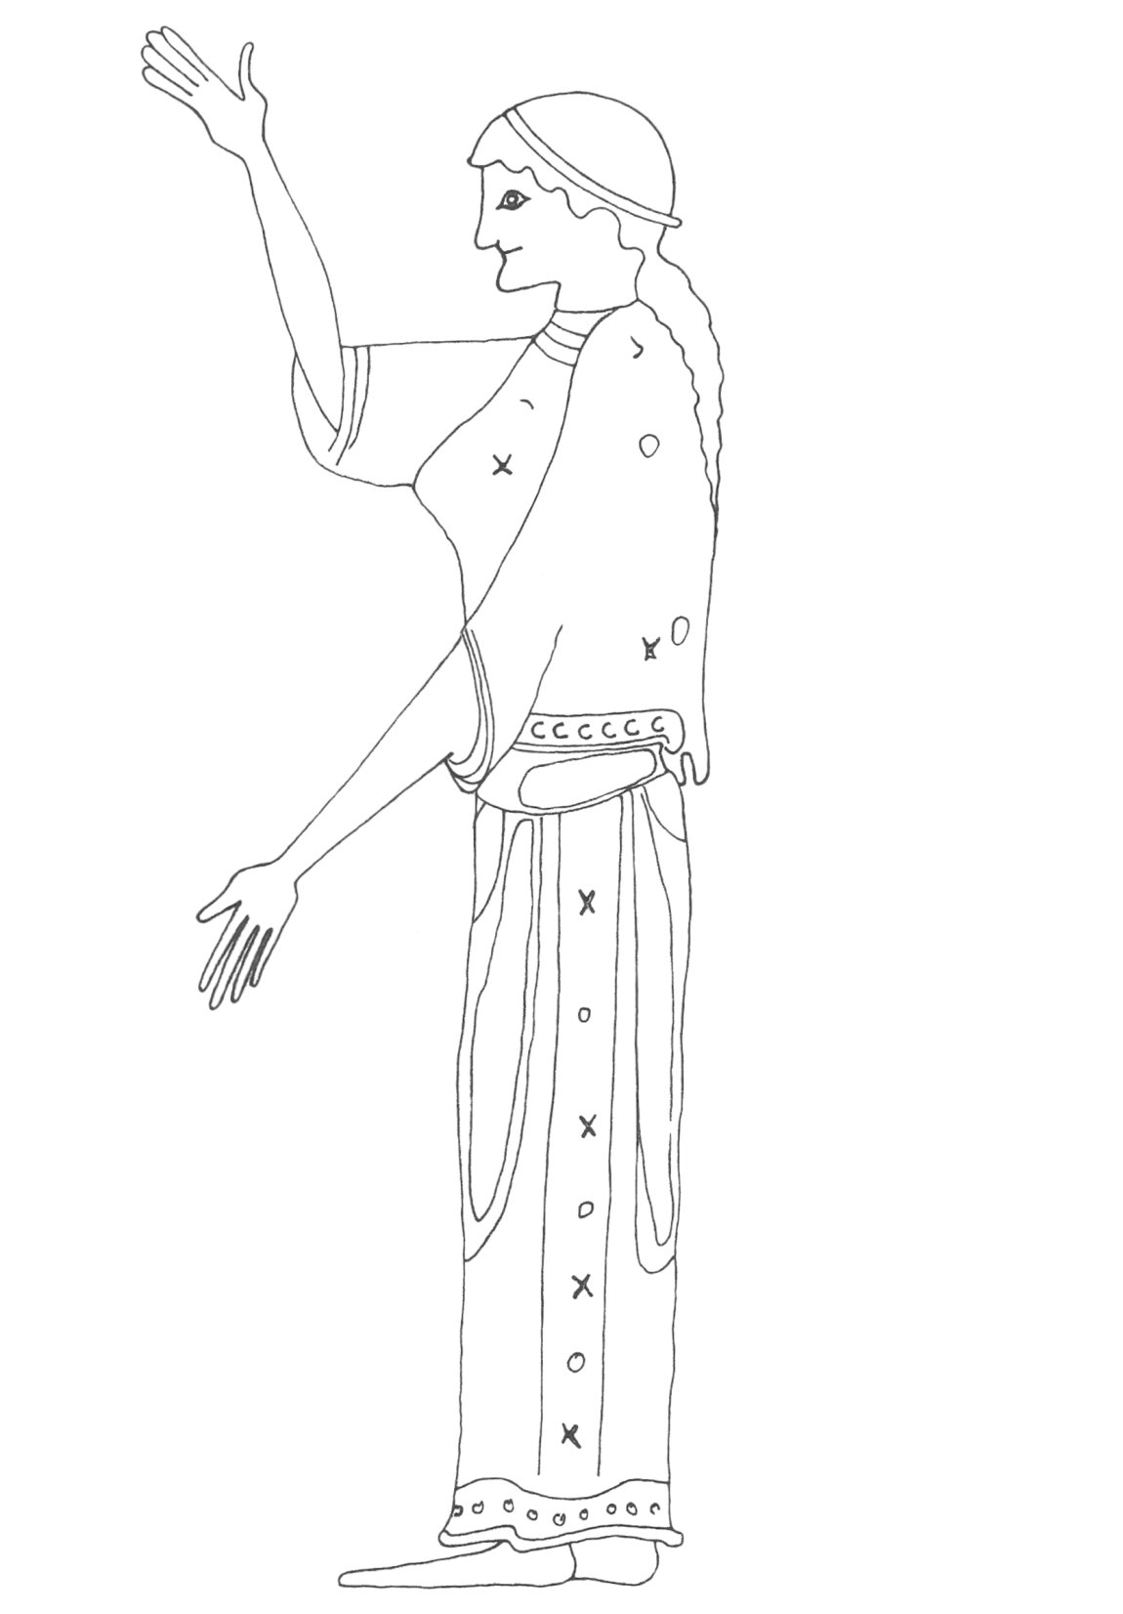

Slide 6
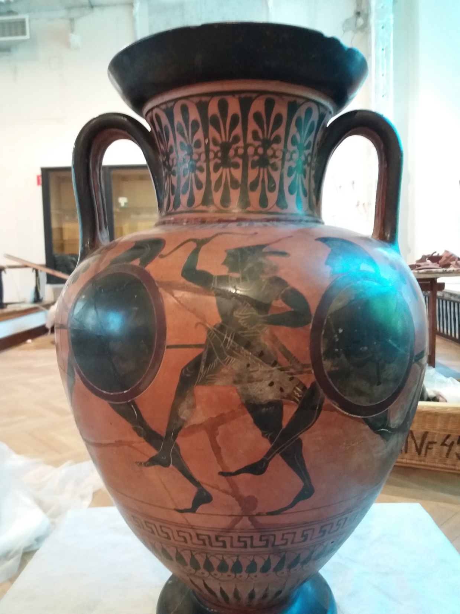
The reverse of
amphora
198042 MNW

Slide 7
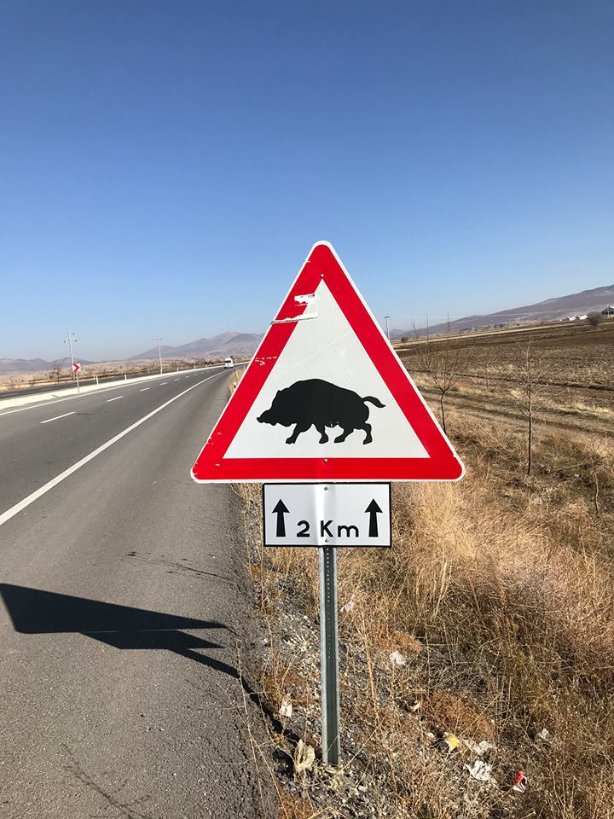
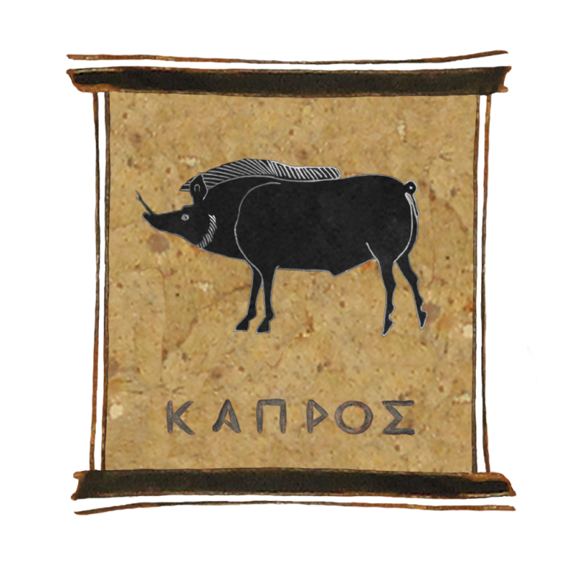

Slide 8
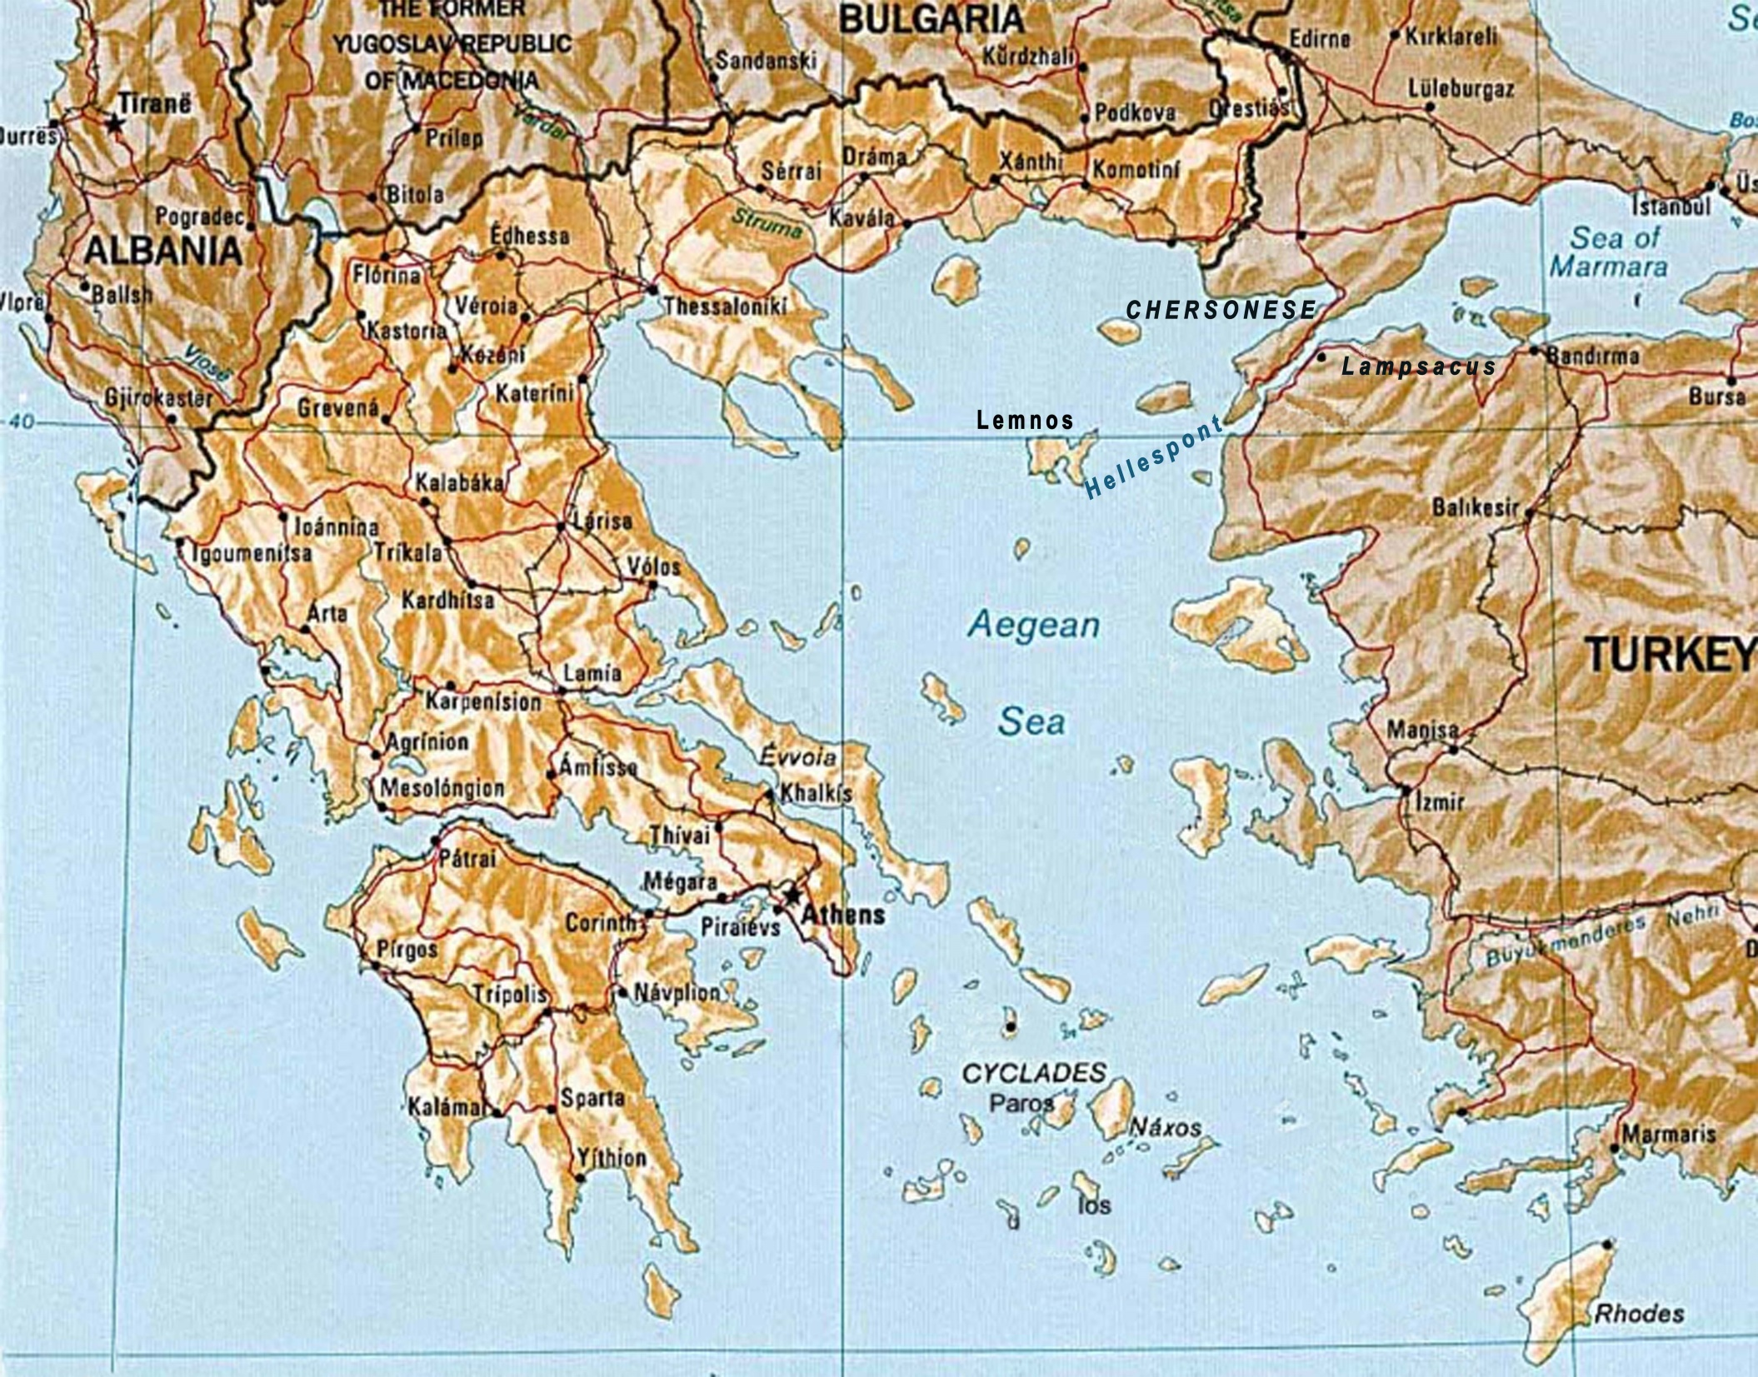

Slide 9
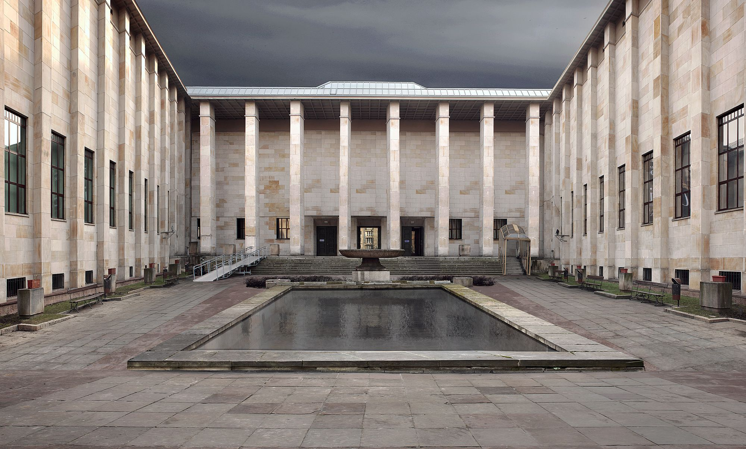
National Museum in Warsaw

Slide 10
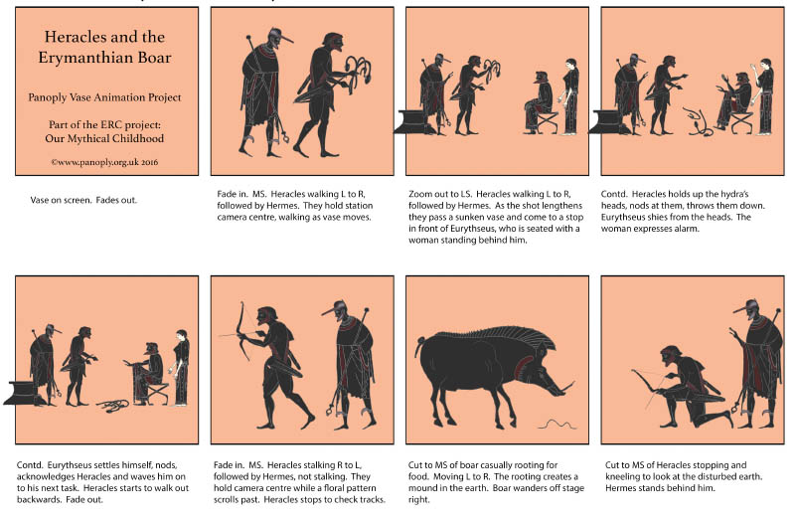

Slide 12
This resource was created by the
Panoply Vase Animation Project
as part of the European Research Council (ERC) funded project:
Our Mythical Childhood... The Reception of Children's and Young Adults' Culture in Response to Regional and Global Challenges
(Grant Agreement 681202; ERC Consolidator Grant led by Katarzyna Marciniak)

