Slide 1
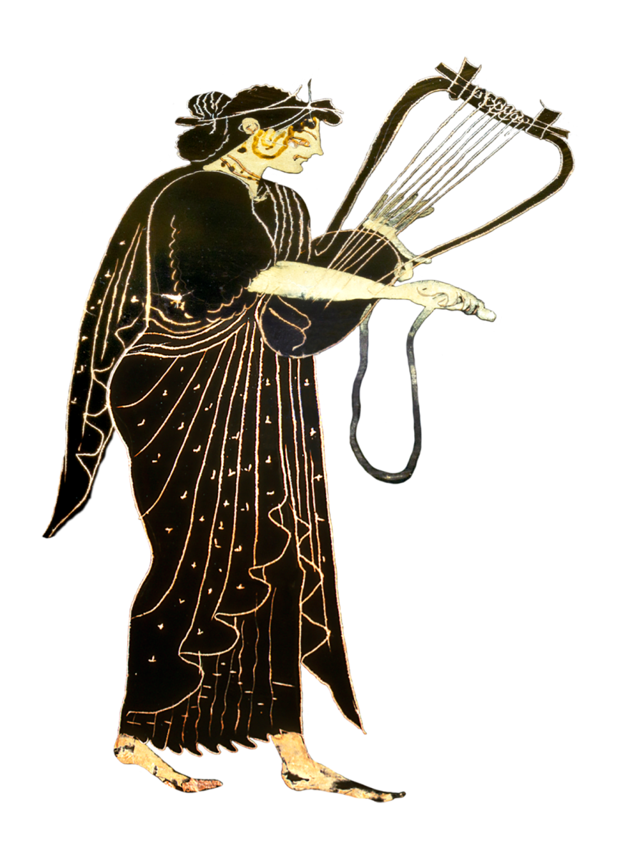
Sappho Fragment 44 Hector and Andromache: A Wedding at Troy

Slide 2
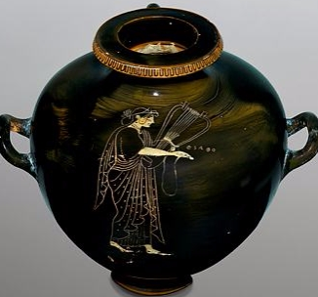
Sappho, hydria
(142333 MNW)

Slide 4
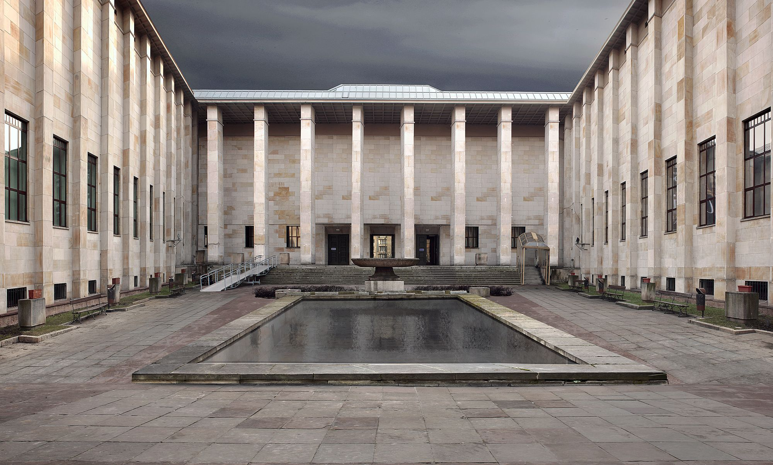
National Museum in Warsaw

Slide 7
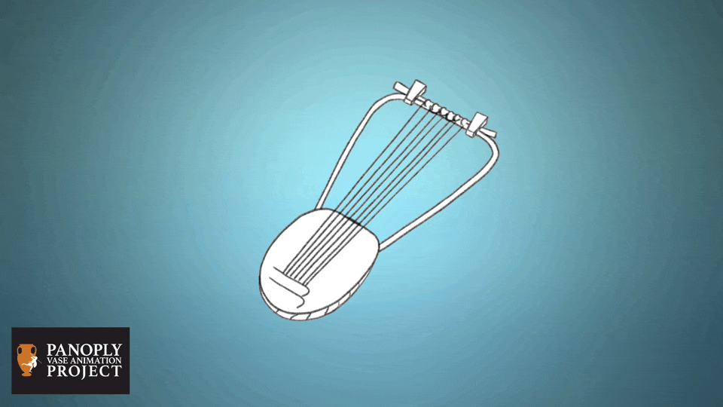

Slide 8
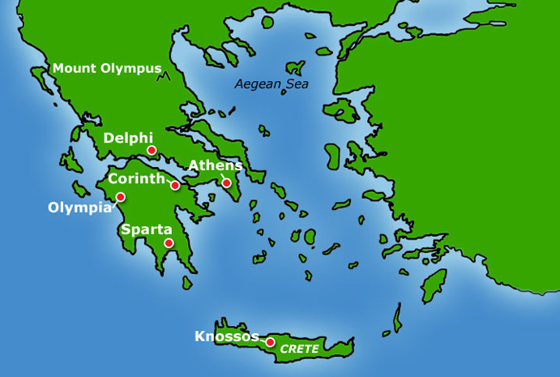
Lesbos

Slide 9
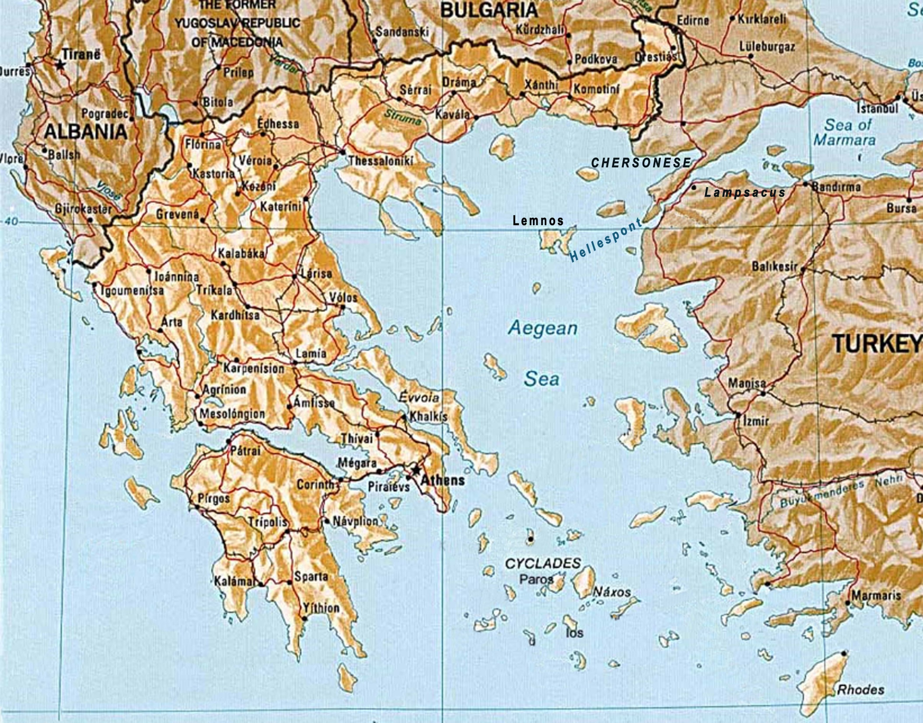

Slide 10
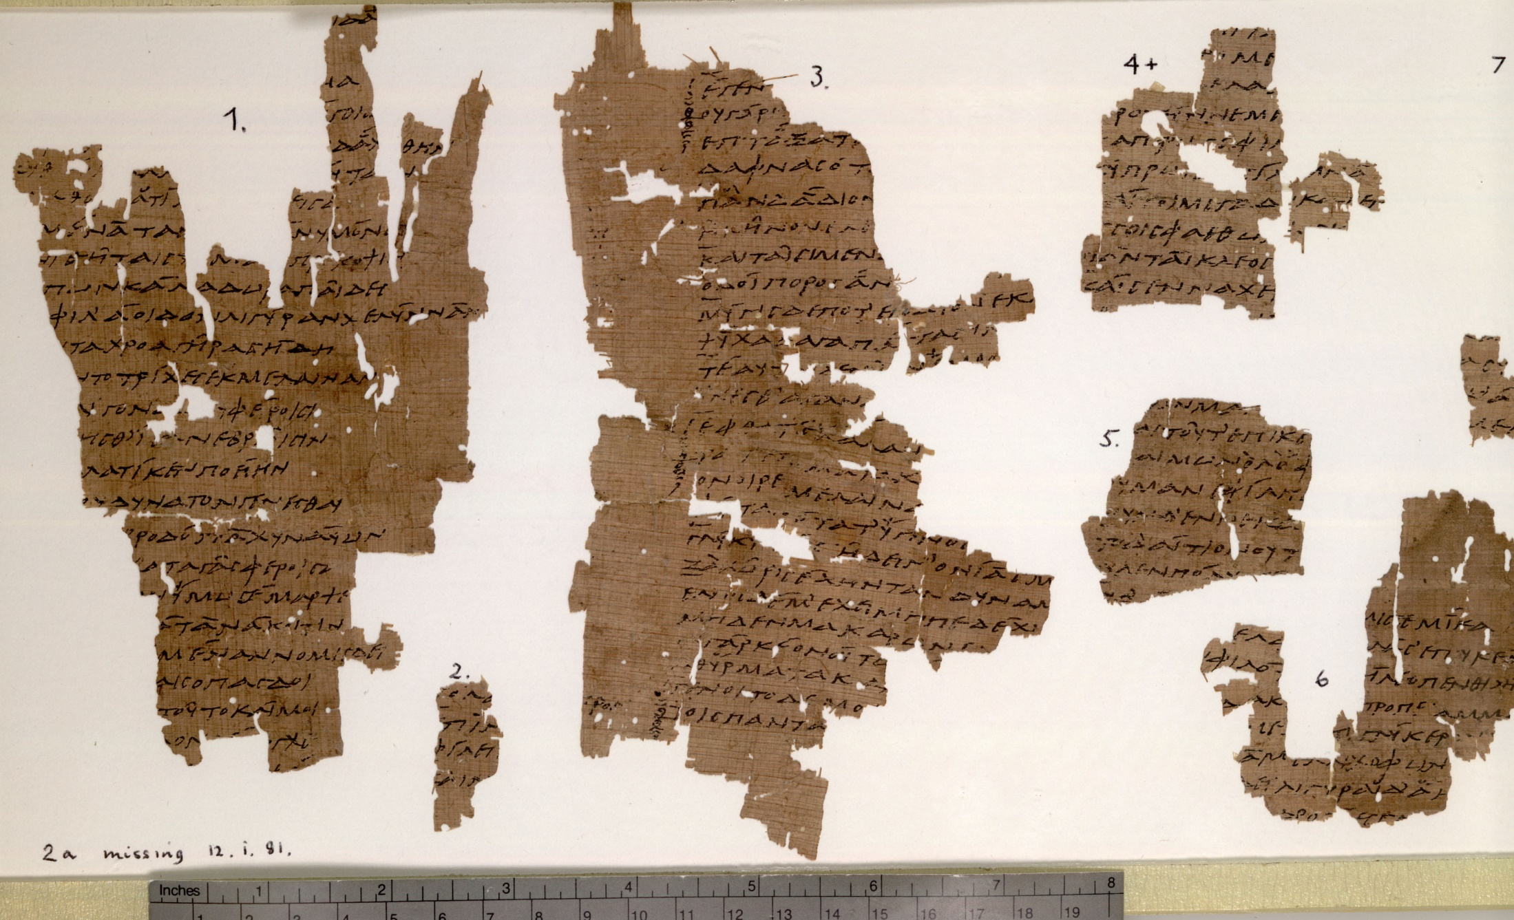
Papyrus often becomes damaged over time, leaving only ‘fragments’

Slide 11
Sappho, Fragment 44
The herald came. Idaeus, the swift messenger:
... "Hector and his companions are leading graceful Andromache from sacred Thebes, in their ships over the salt sea...
Many gold bracelets and purple robes, finely-made ornaments and countless silver drinking cups and ivory."
So he spoke and Hector's dear father leapt up quickly.
The news reached his friends around the wide city.
The men of Troy yoked mules to the smooth-running carriages and the crowd of women and neat-ankled girls climbed aboard. The daughters of Priam travelled separately. Young men harnessed horses to chariots.
Looking like gods, they travelled into Troy.
The sweet sound of the aulos and kithara mixed with the noise of the castanets.
The girls sang a holy song which echoed wonderfully into the sky.
Everywhere in the streets there were bowls and cups.
There was myrrh, cassia, and frankincense mingled.
The women dried out "Eleleu!"
All the men sang a lovely song to Apollo – the far-shooter and beautiful lyre player.
And they sang a song of godlike Hector and Andromache.

Slide 13
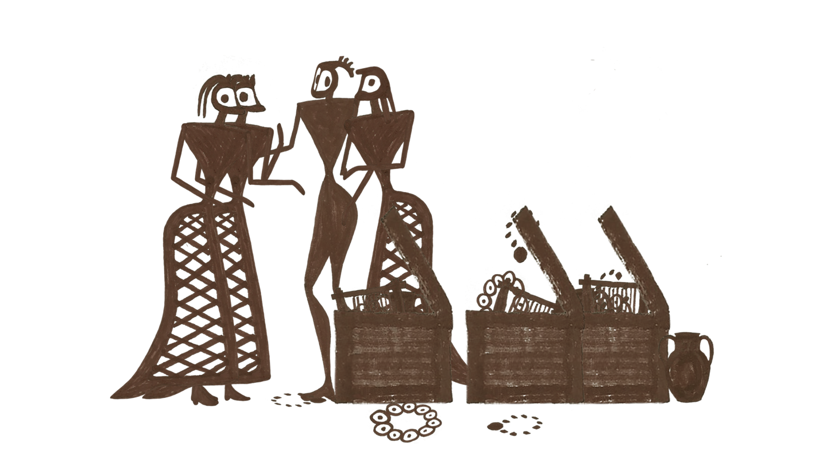

Slide 14
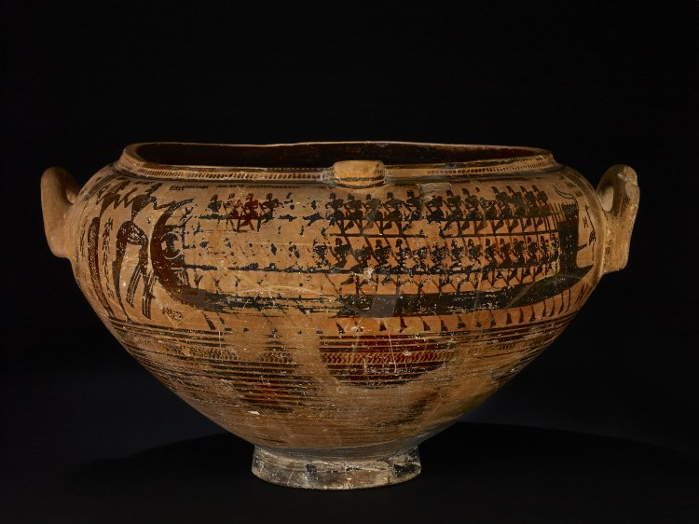
Thebes krater, c.730BCE, British Museum

Slide 15
1200BCE, traditional date Trojan War
c.900-700BCE geometric pottery
c.610-570BCE, Sappho alive
c.525-500BCE, Sappho vase produced
c.150BCE, Sappho 44 rewritten on papyrus and then disposed of

Slide 17
This resource was created by the
Panoply Vase Animation Project
as part of the European Research Council (ERC) funded project:
Our Mythical Childhood... The Reception of Children's and Young Adults' Culture in Response to Regional and Global Challenges
(Grant Agreement 681202; ERC Consolidator Grant led by Katarzyna Marciniak)

